Slide 1
International Volunteer
By Trinh Pham ( Sky )

Slide 2
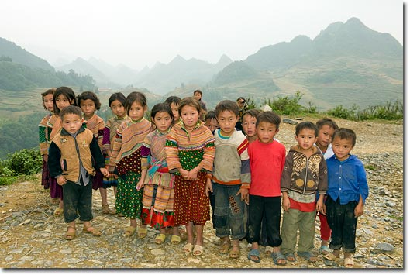

Vietnam Project
Students Scholarship
Environmental Educating
Library Building
Supporting Cancer Children
Poverty Reduction and
End Hungers

Slide 3
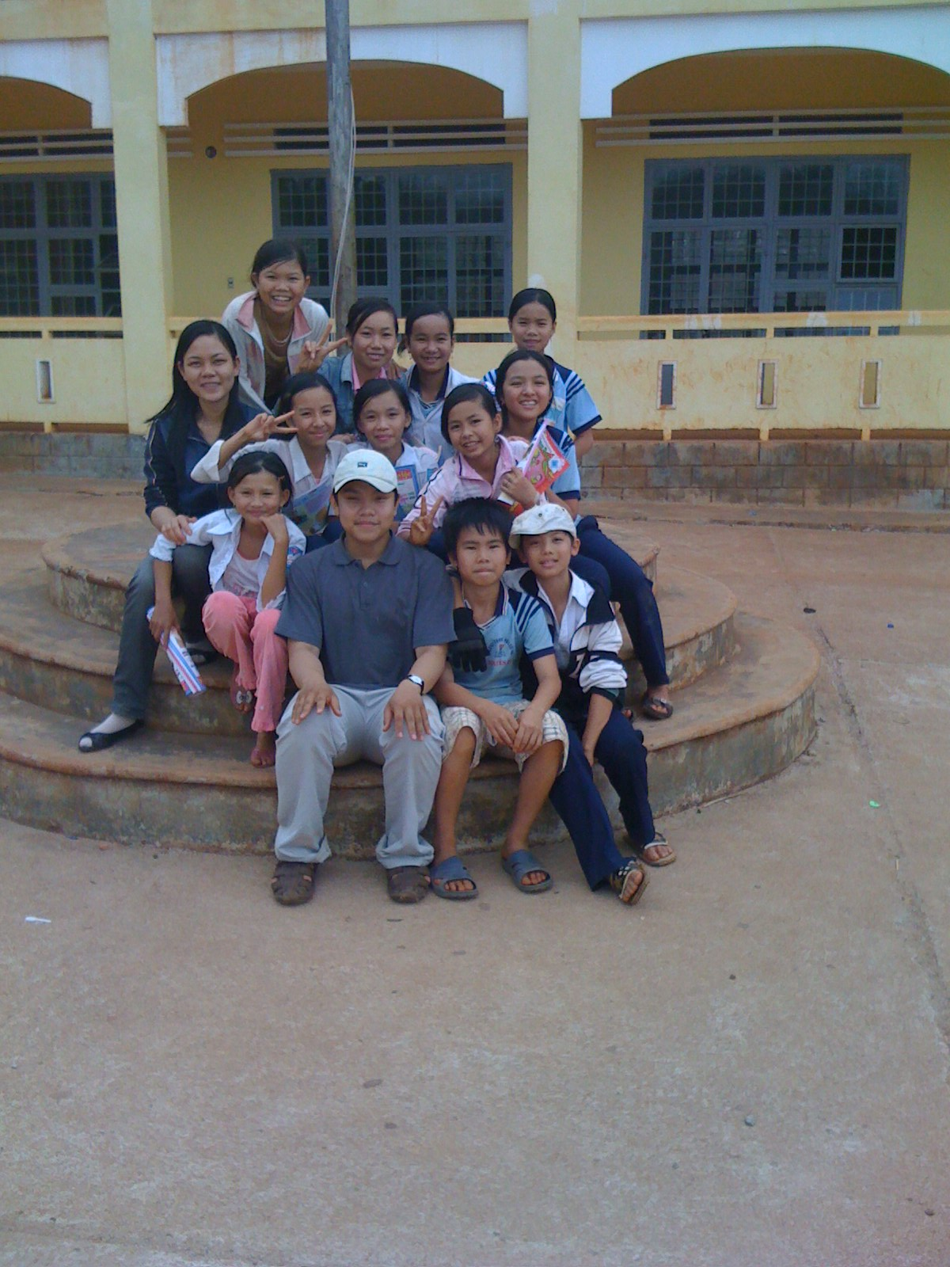
Library Project
Understanding about the impacts brought by the library on the students, teachers and the schools.
Reading is cornerstone of education, but poverty has put these children at a significant disadvantage.
Lack of quality and developmentally appropriate reading materials negatively impacts their academic performance and their motivation to learn.

Slide 4
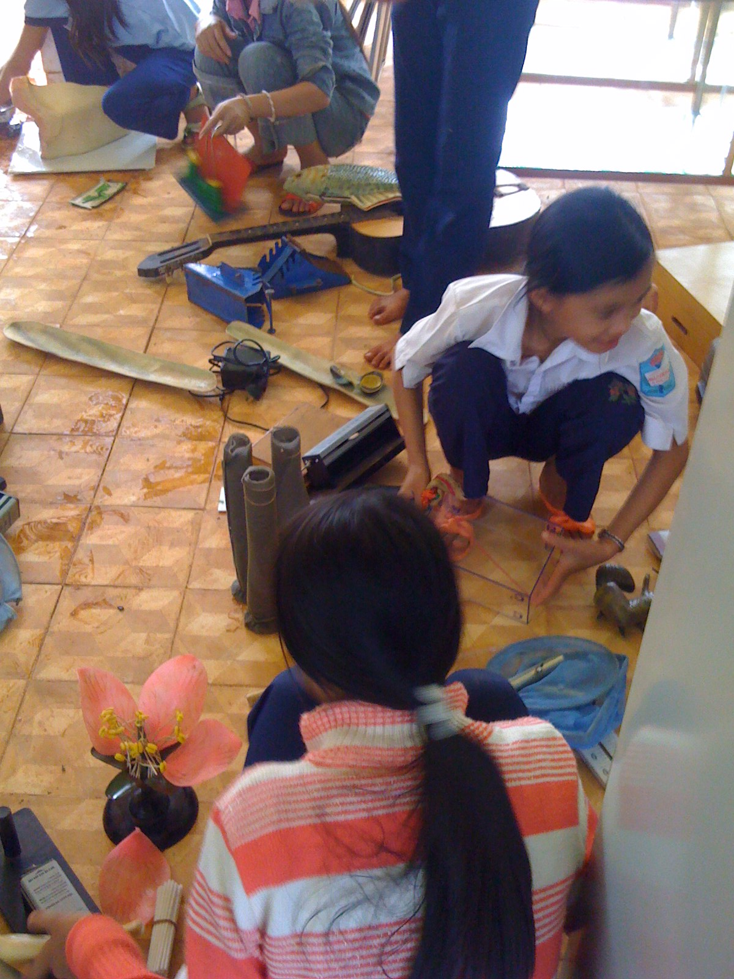
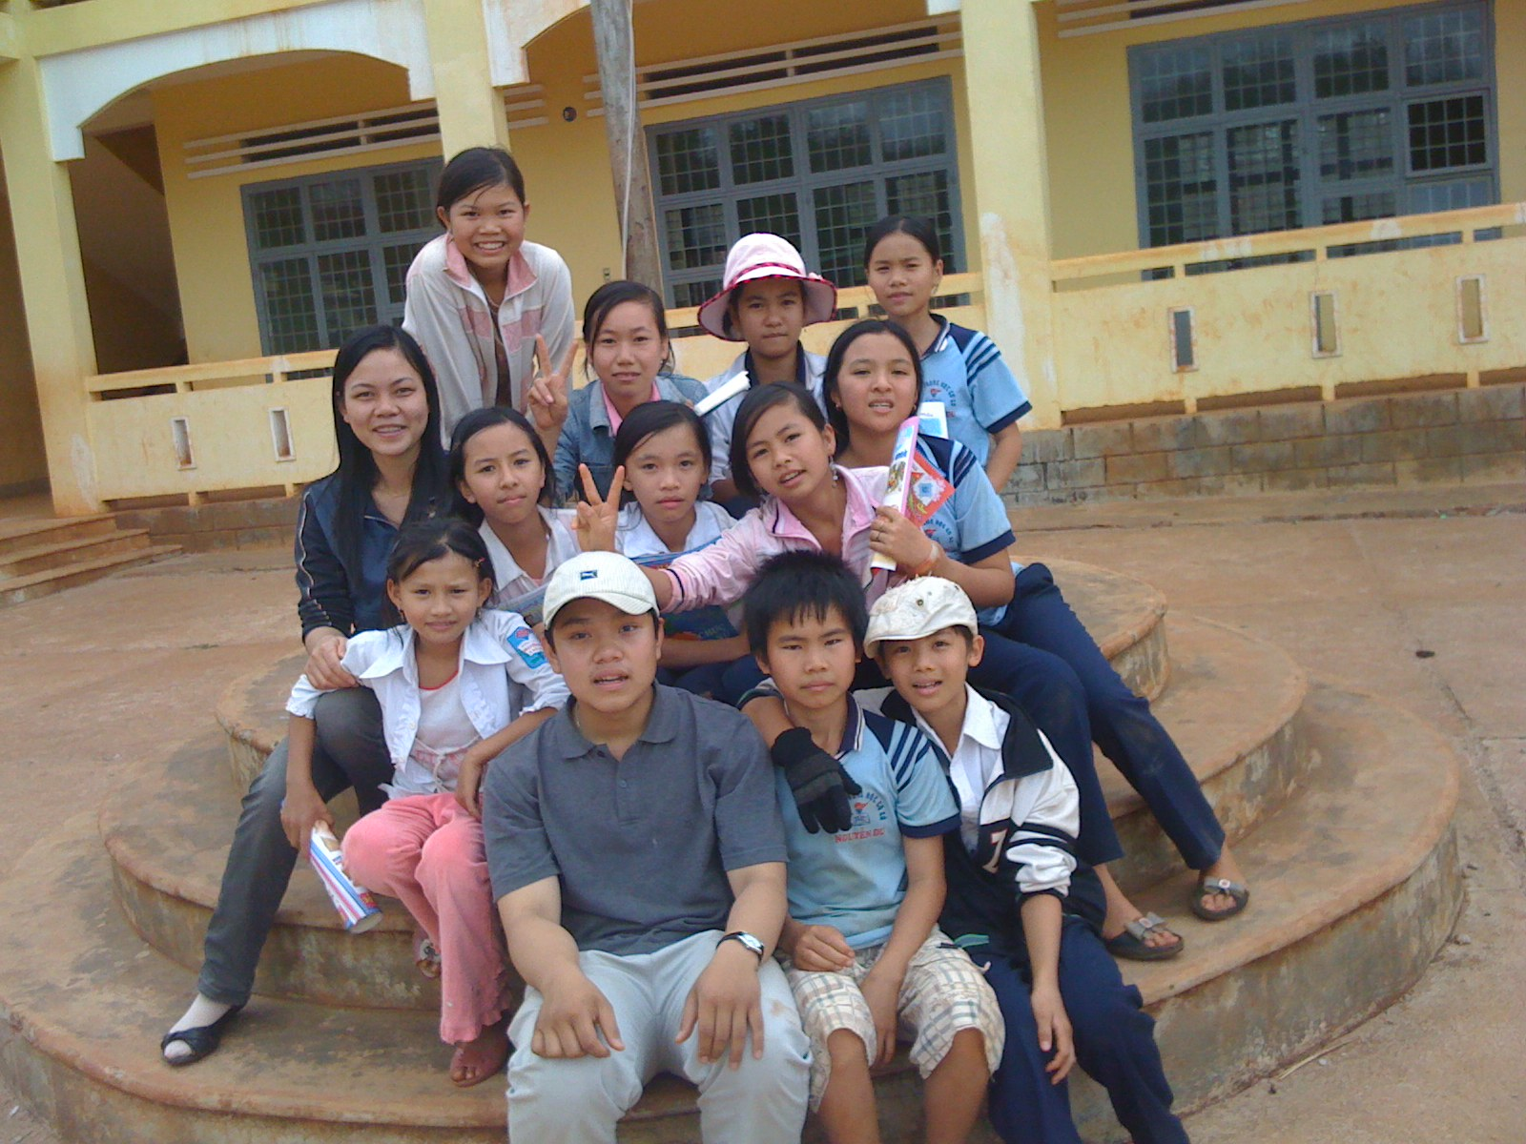
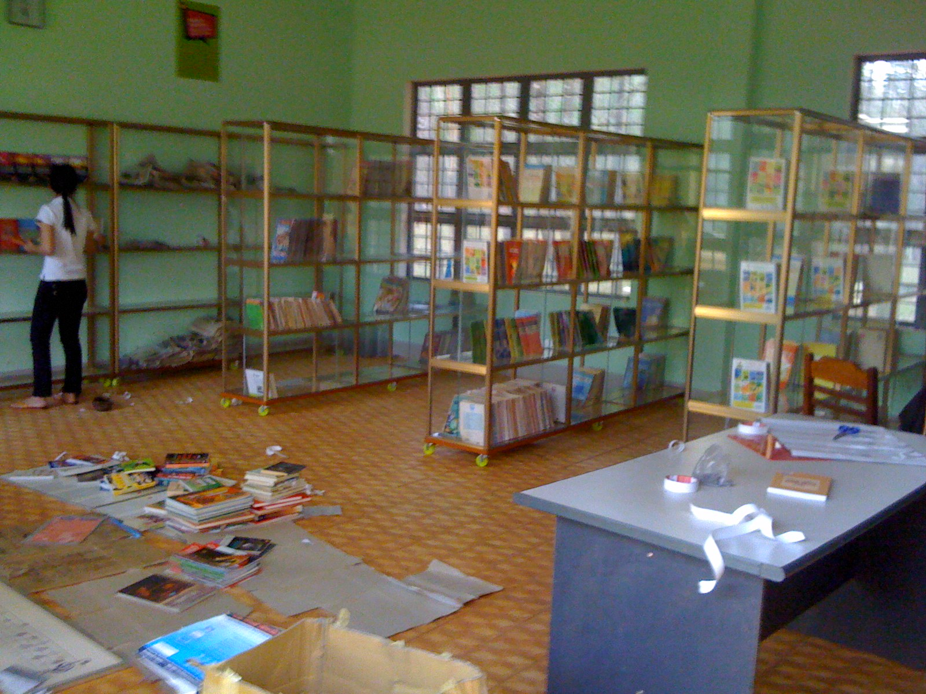
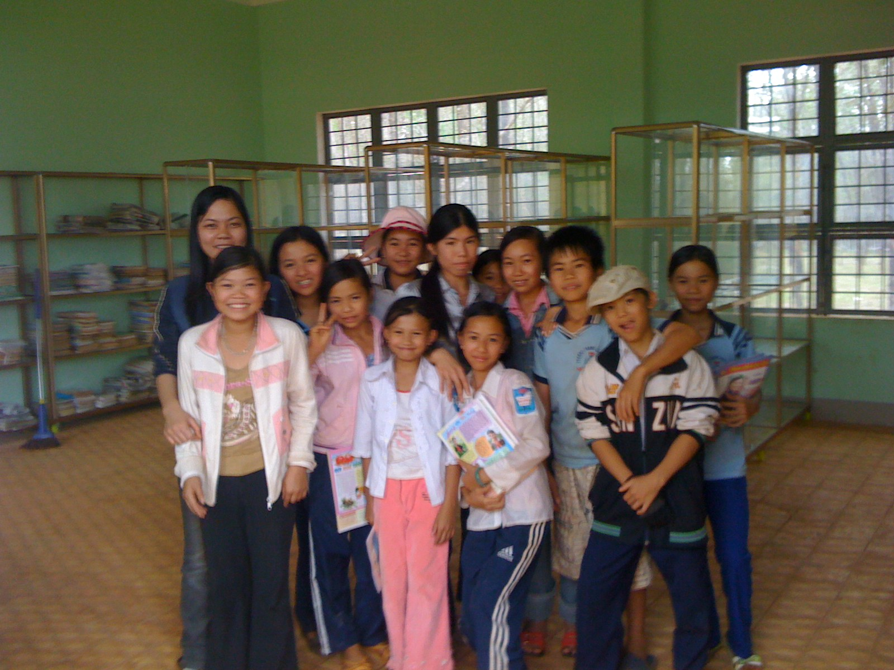

Slide 5
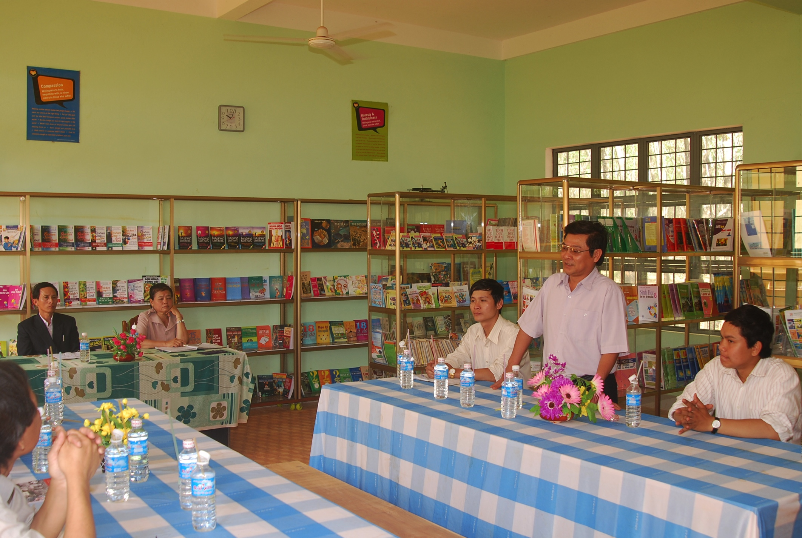
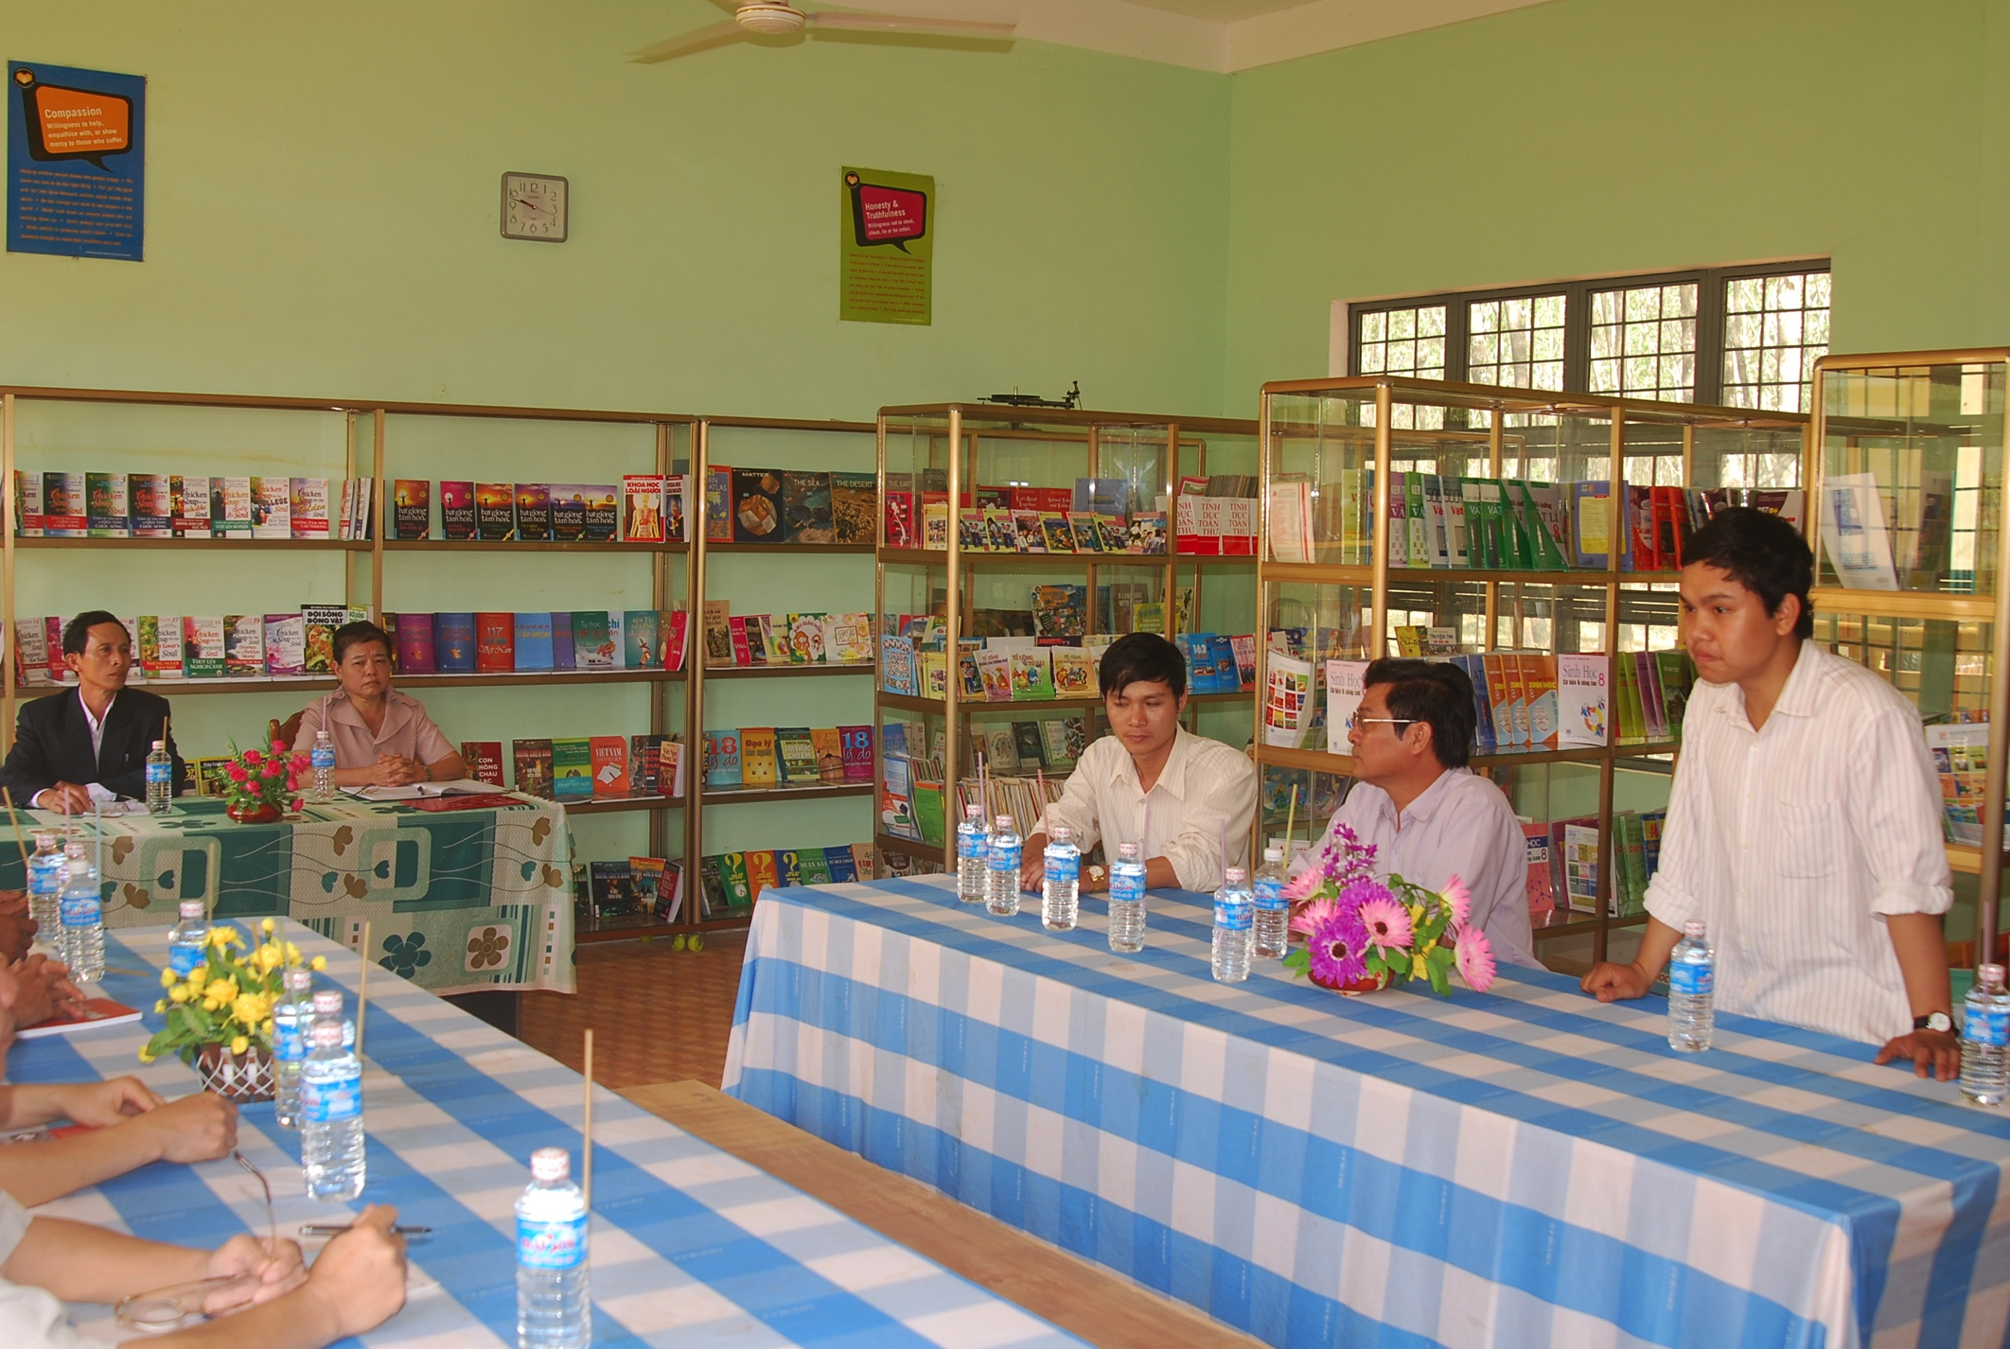
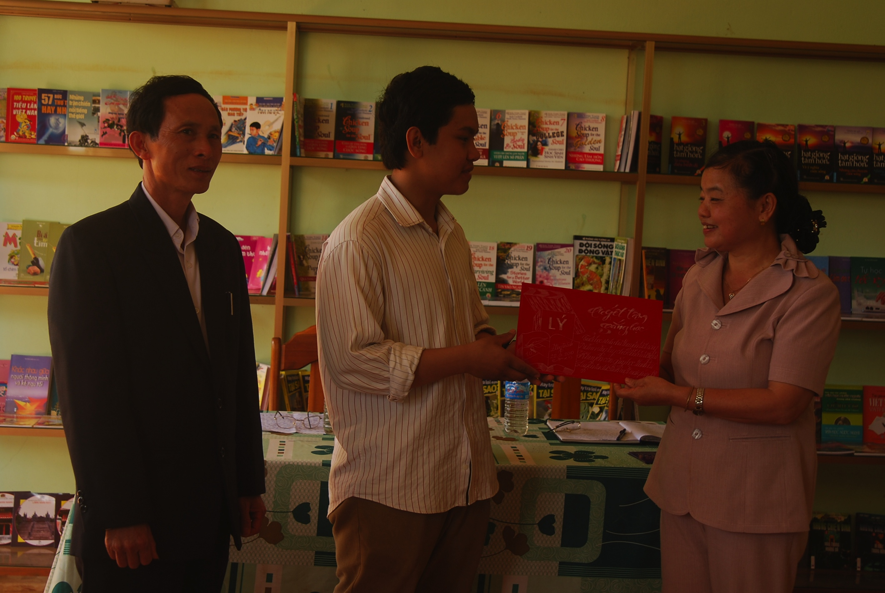
The Project was very successful and welcomed by the Province Governnor and many school Principles in Gia Lai Province

Slide 6
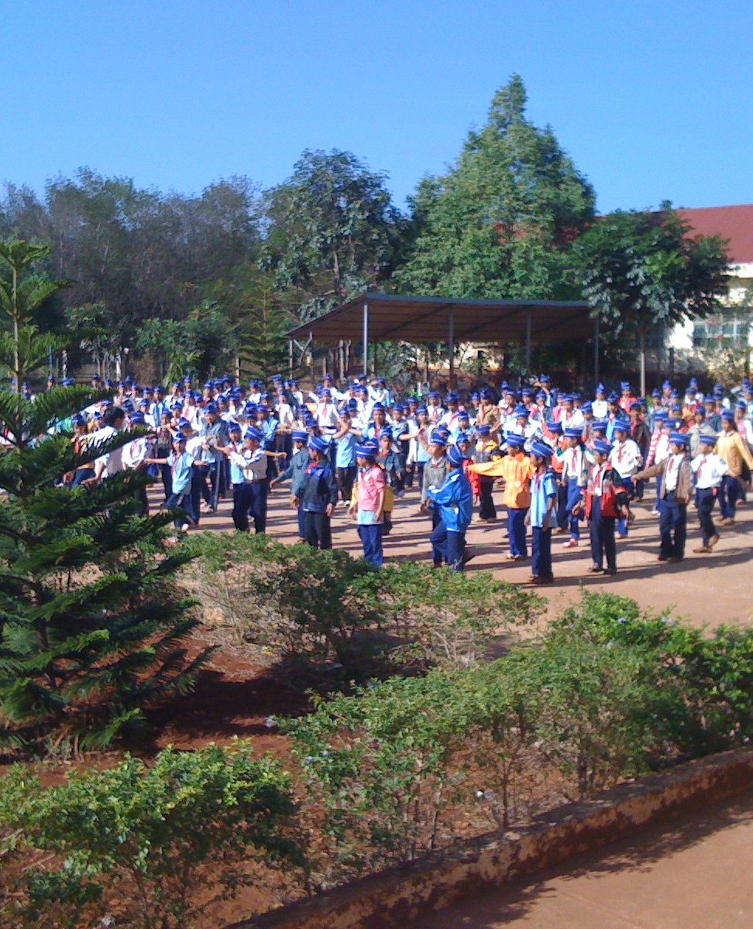
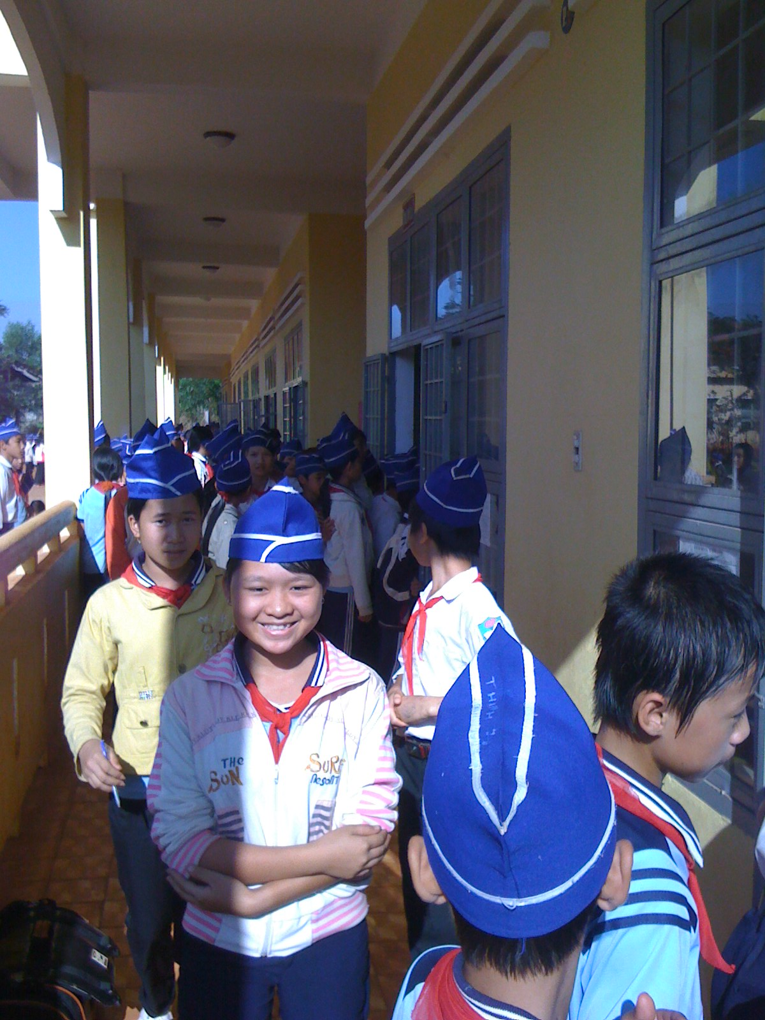

Slide 7
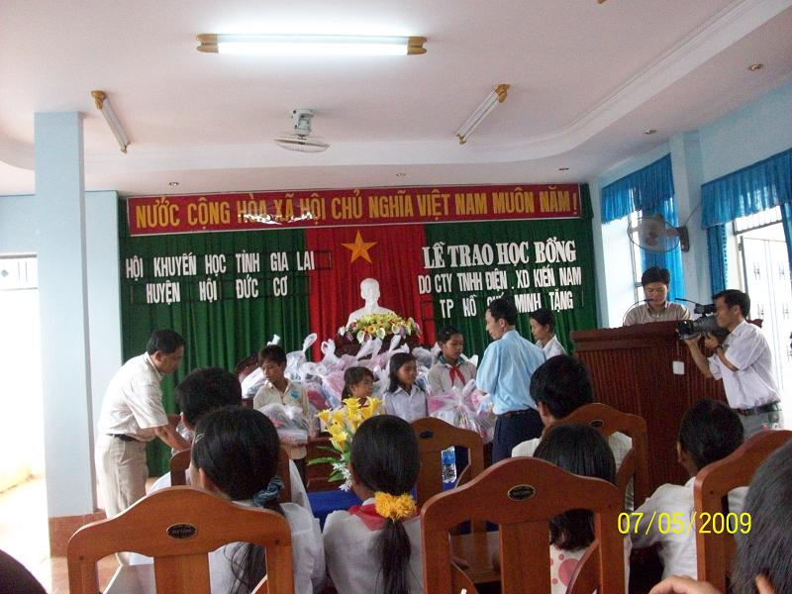
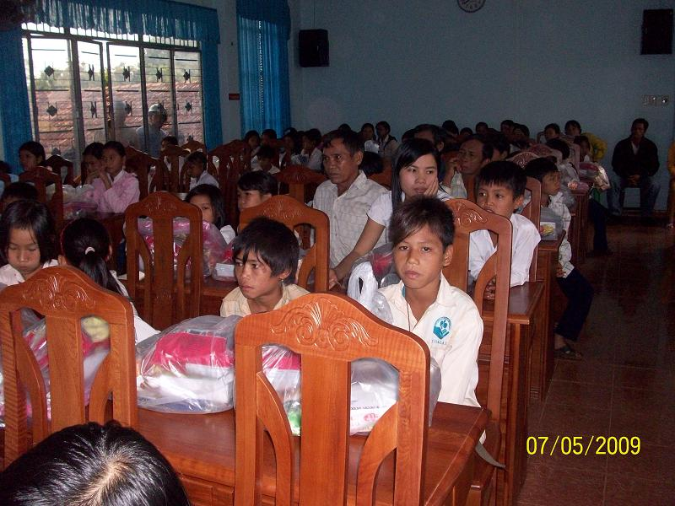
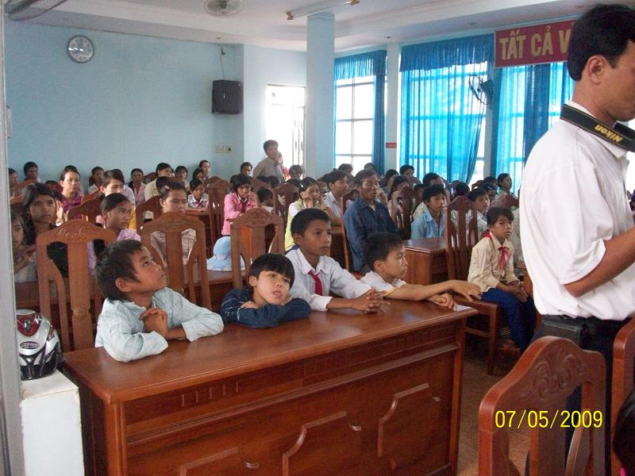
Giving Scholarship is the best way to motivate student to learn and continue with their education

Slide 8
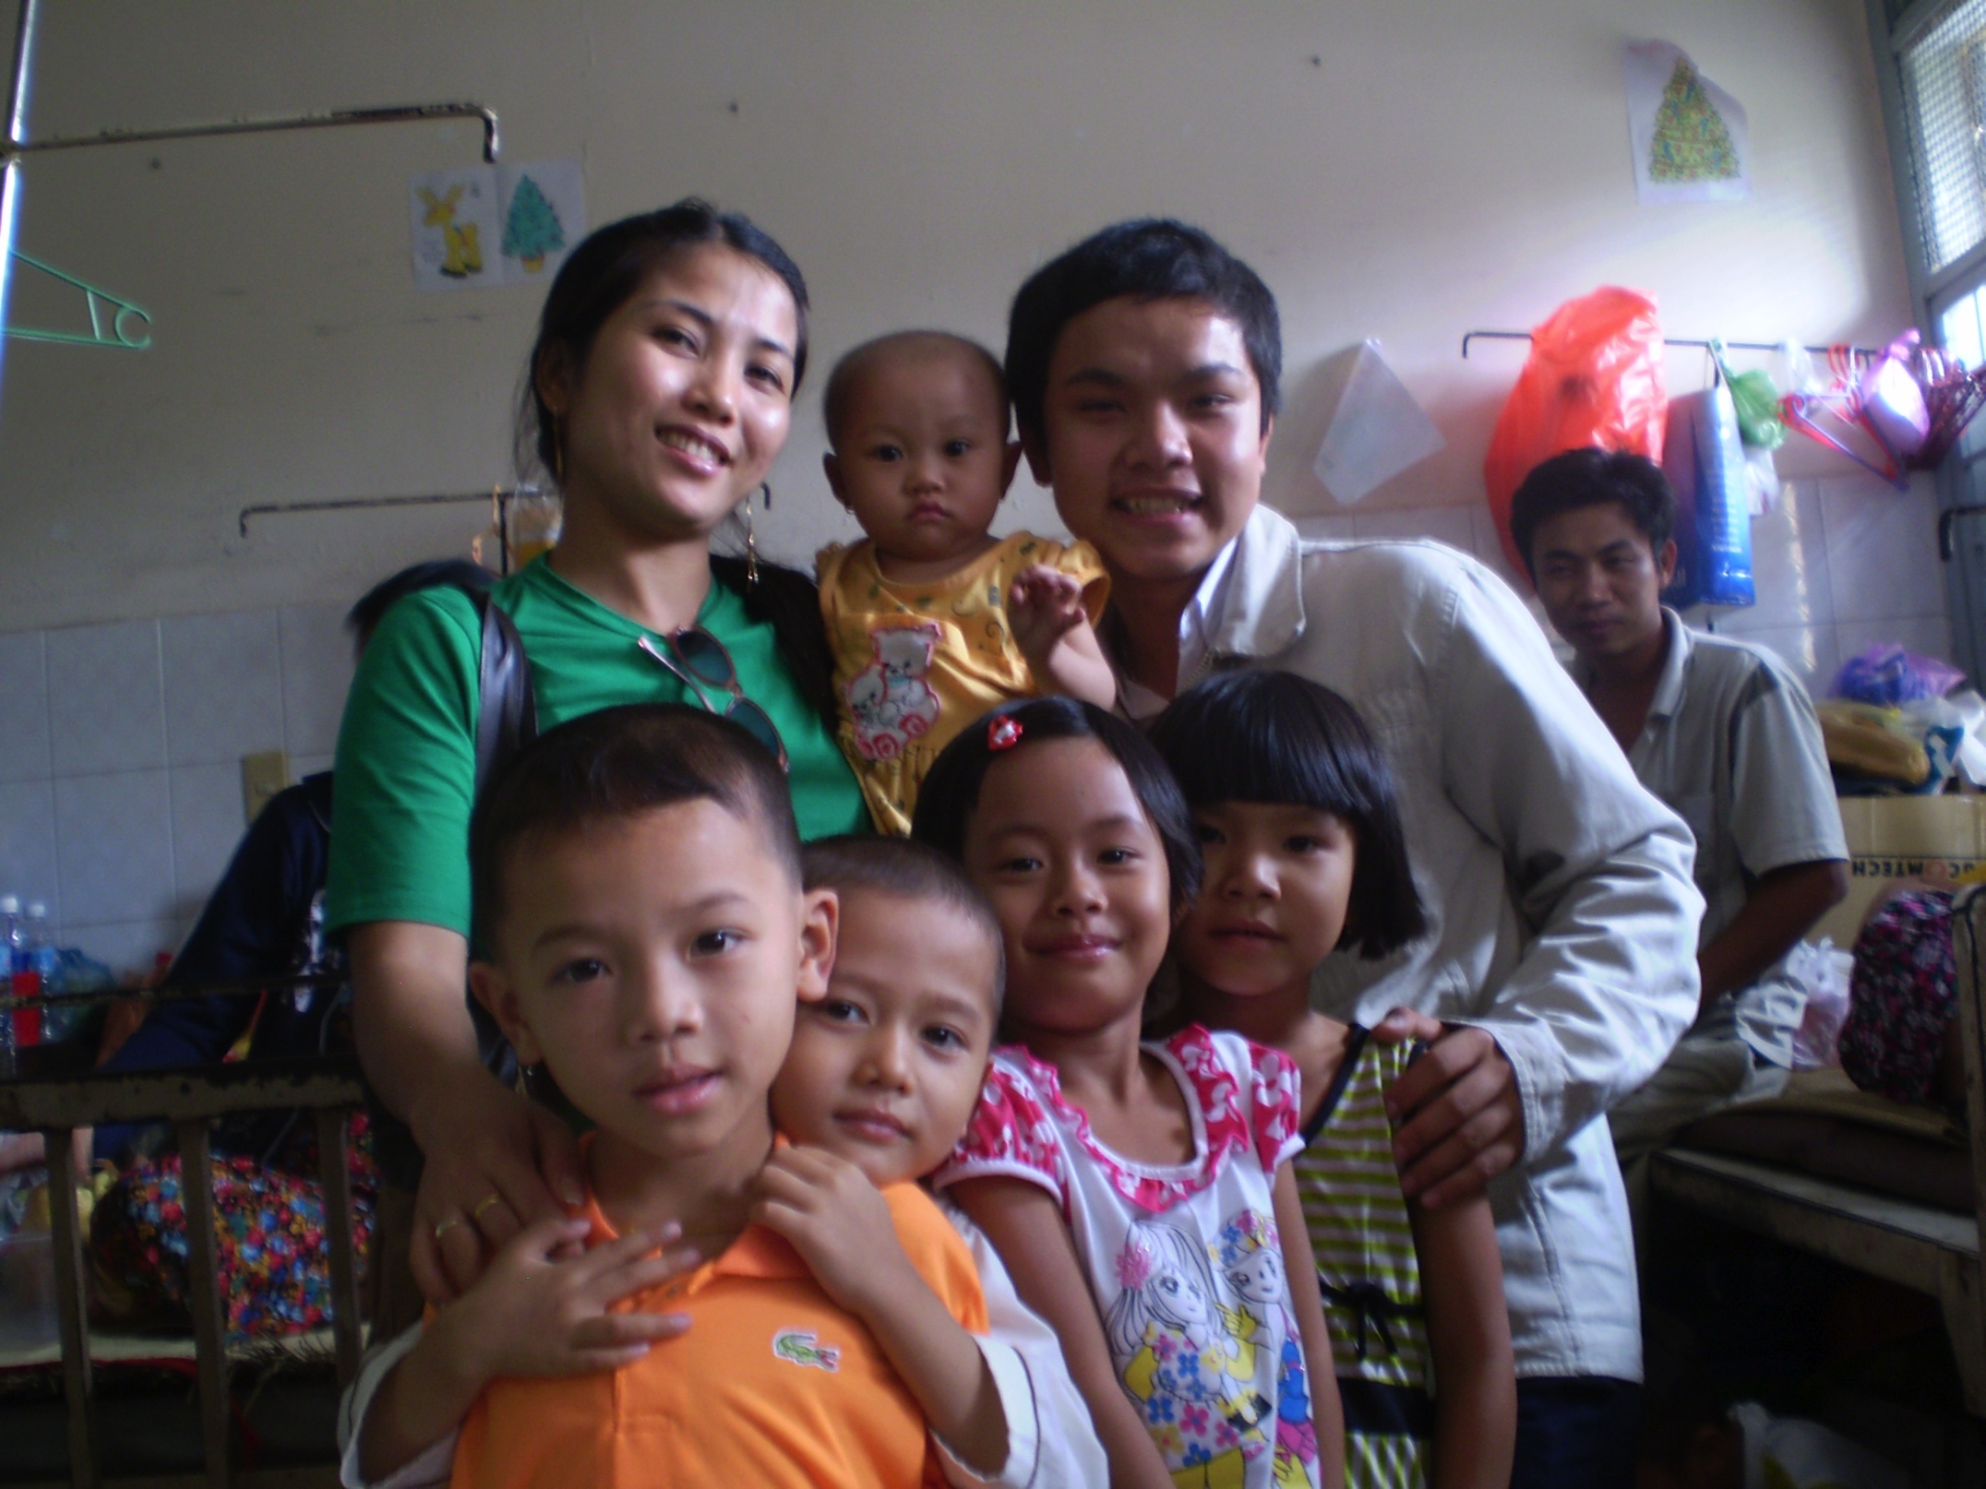
Support Cancer Children
Cancer control in Viet Nam has to deal with challenges such as poor quality of cancer mortality and morbidity data, shortage of resources, lack of data on programme and limited knowledge of general practitioners and public about cancer

Slide 9
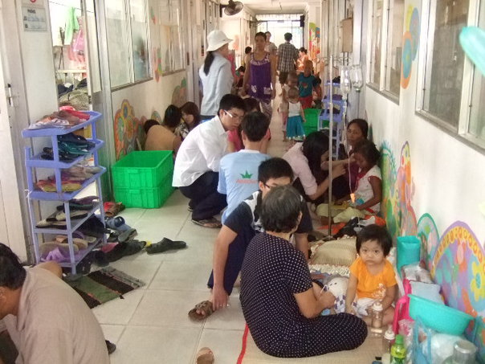
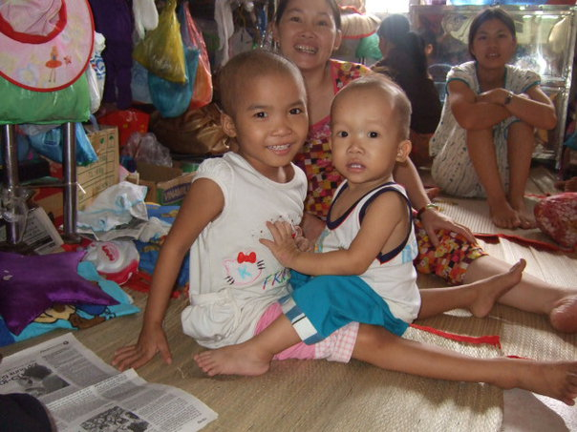
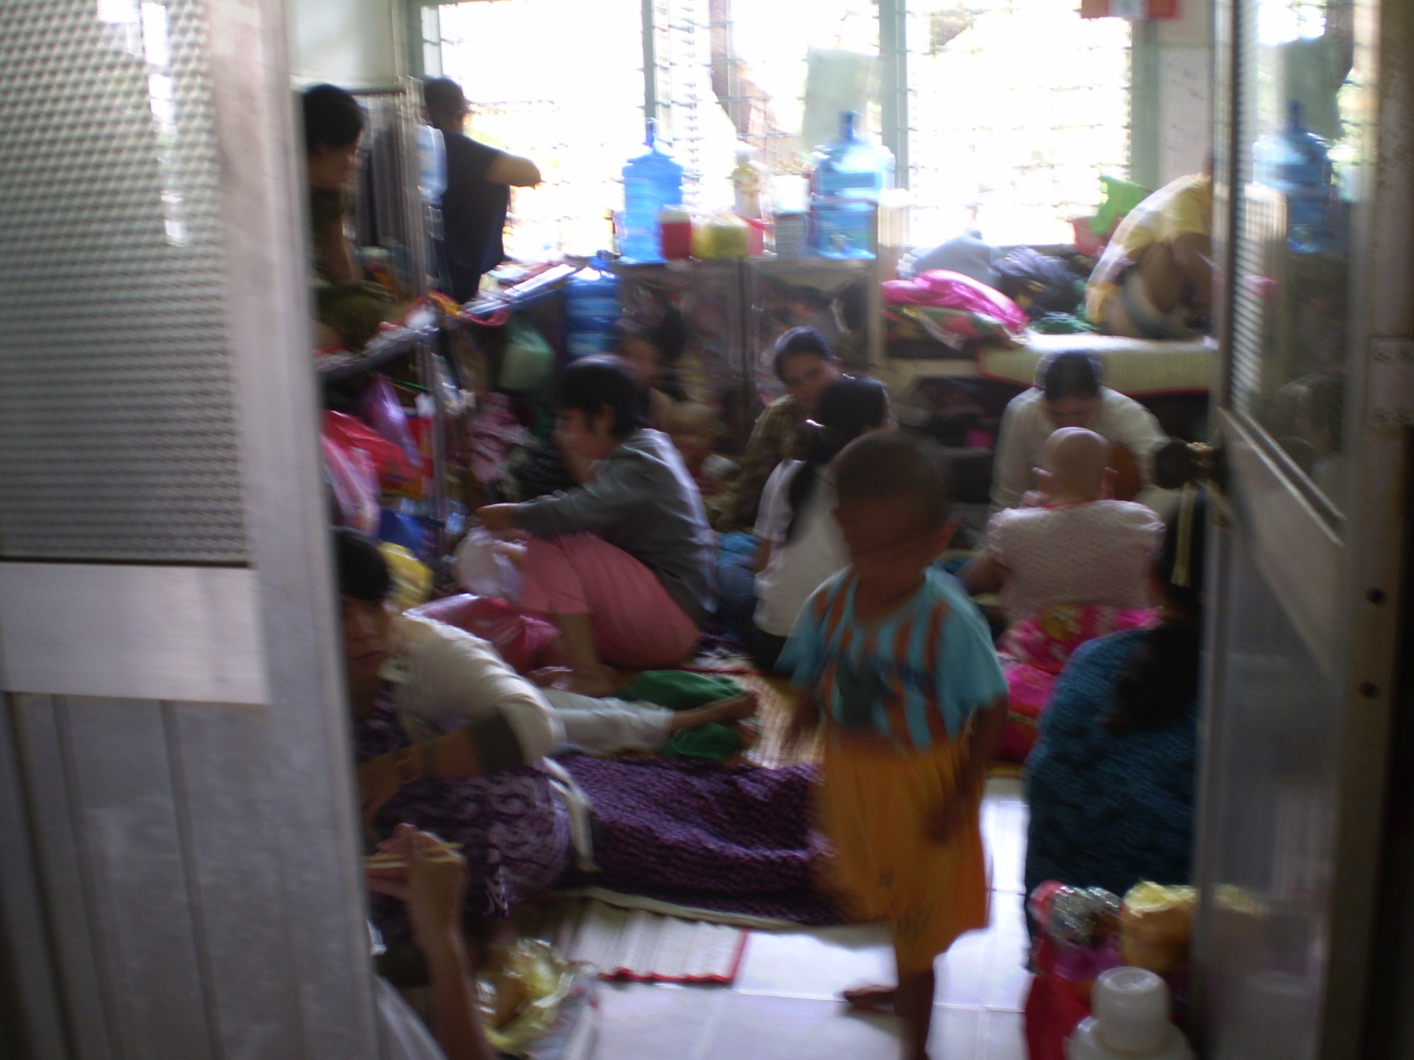
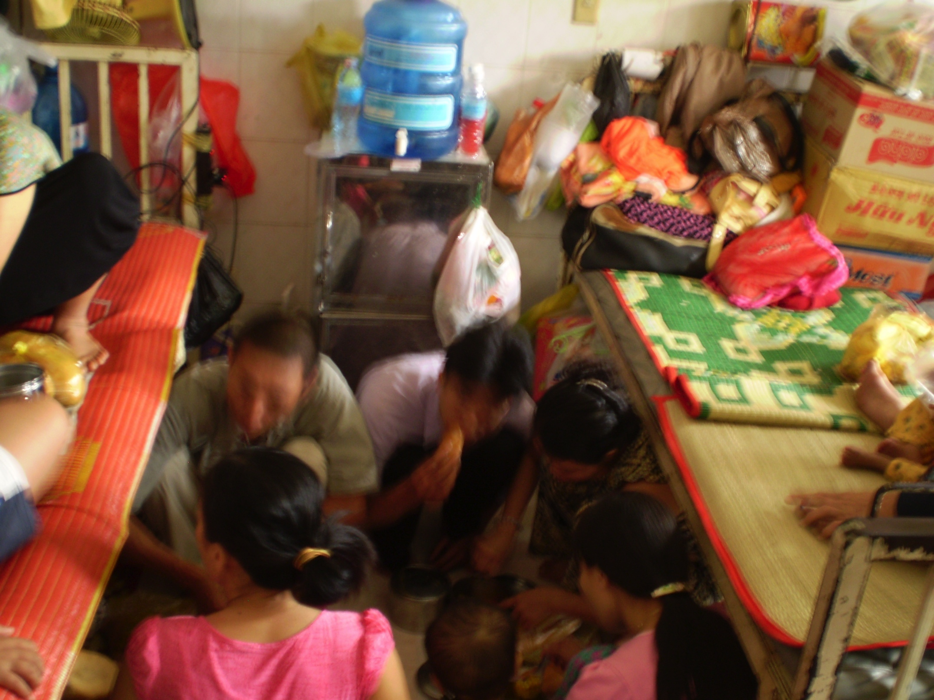
Vietnam Hospital

Slide 10
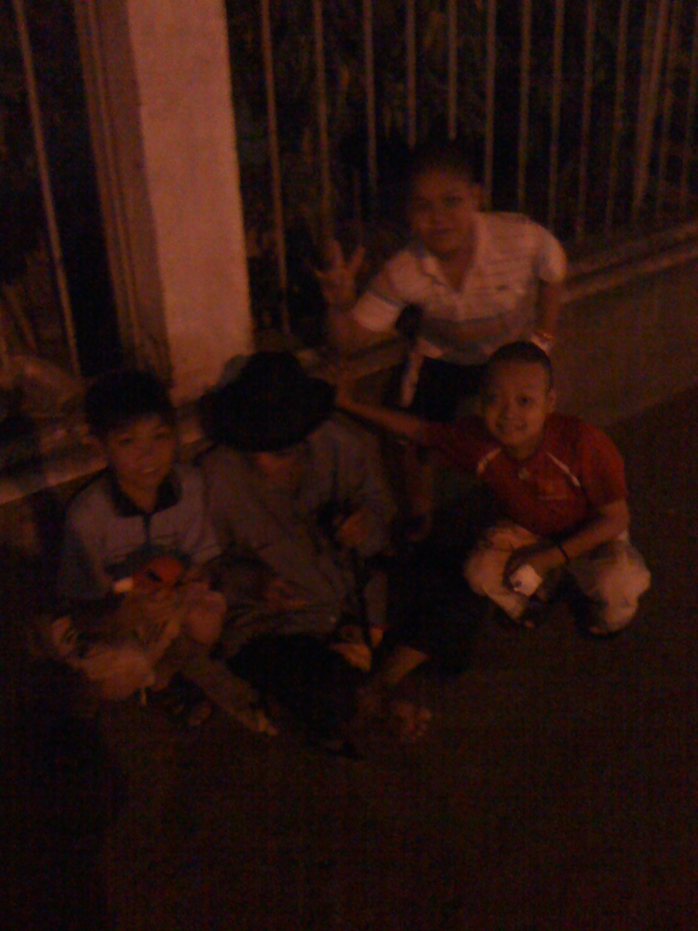
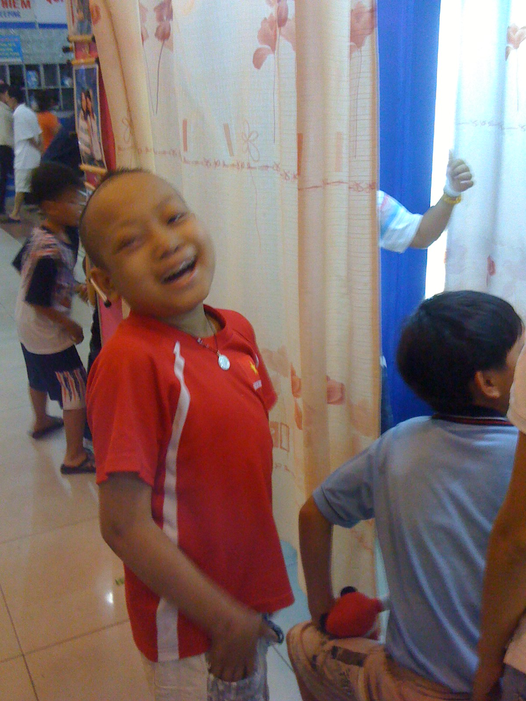
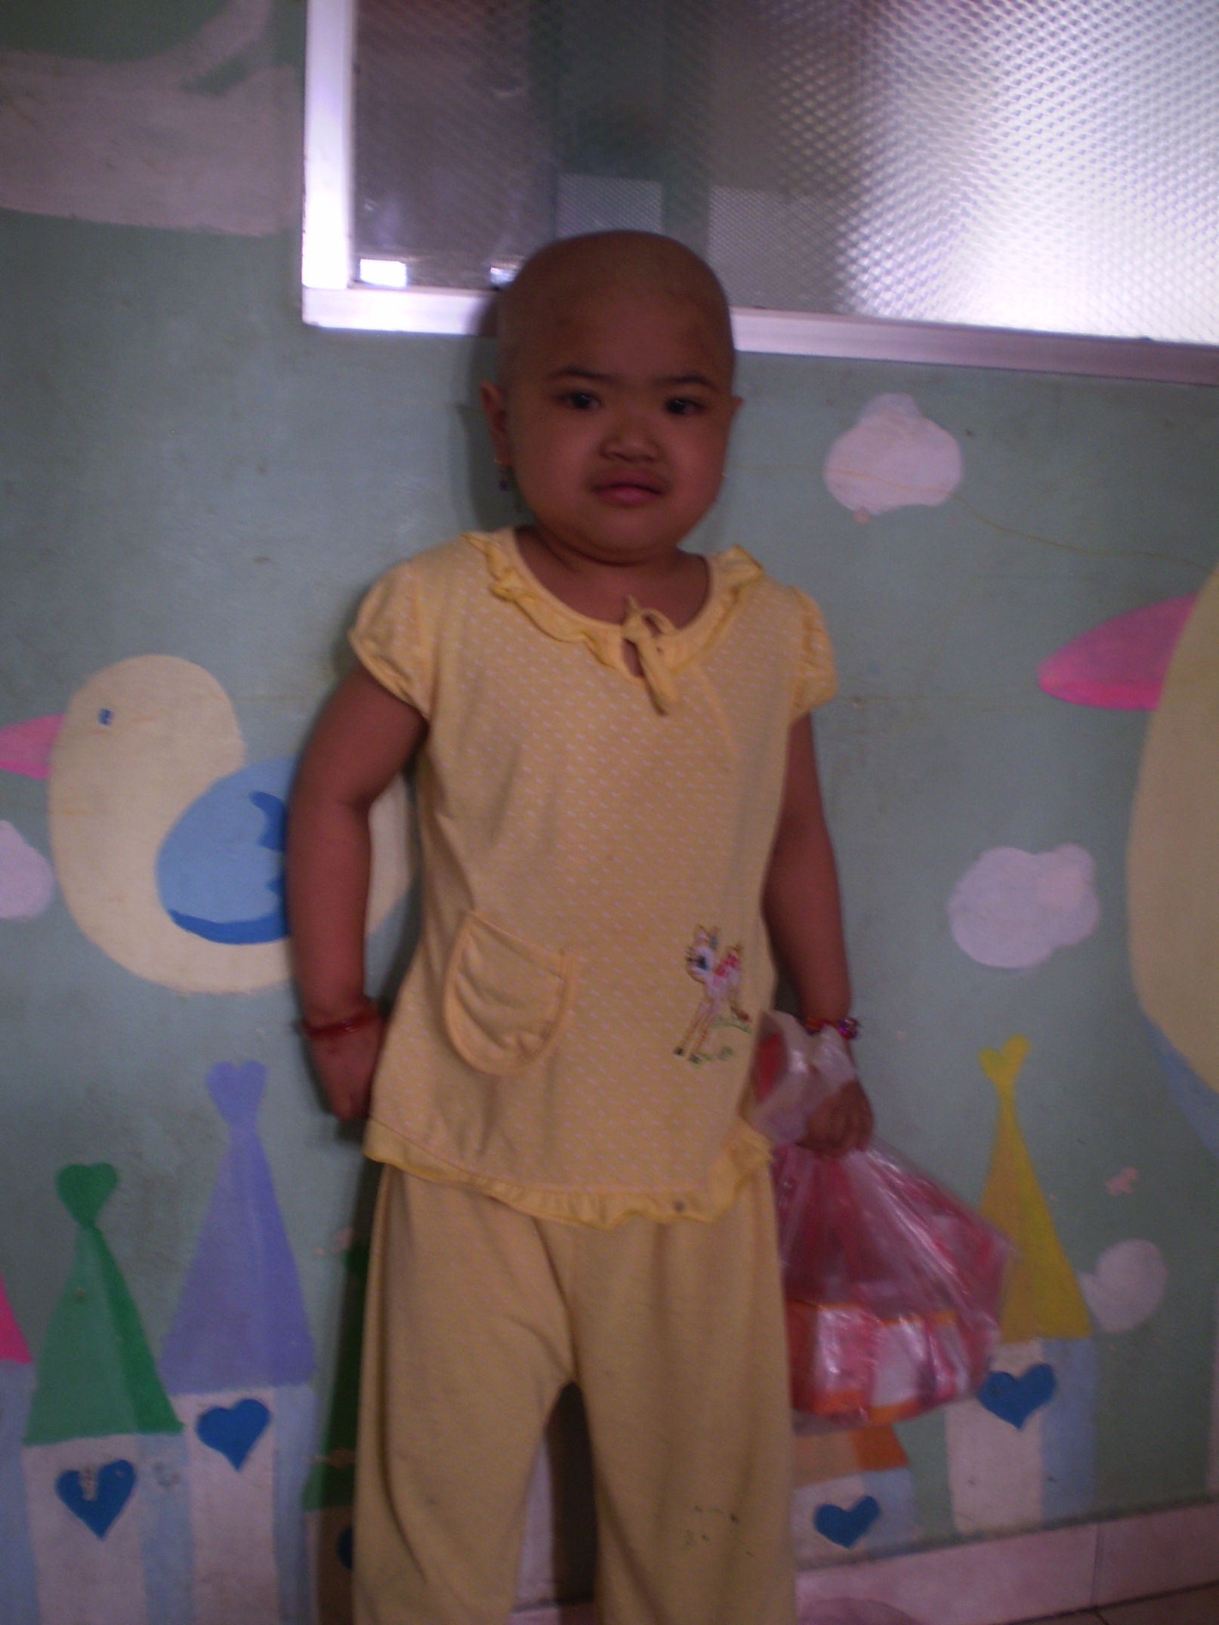
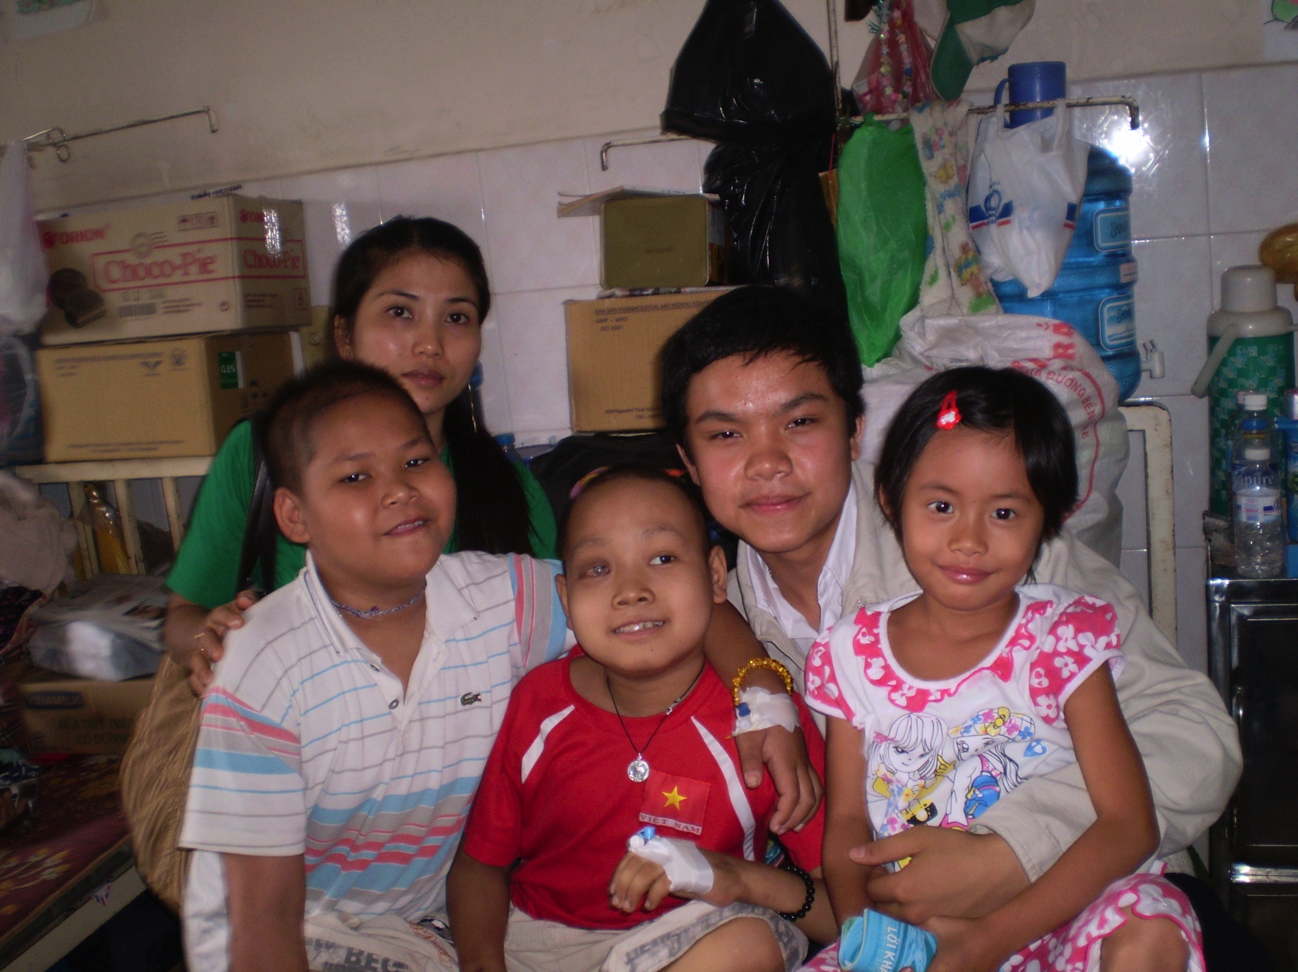
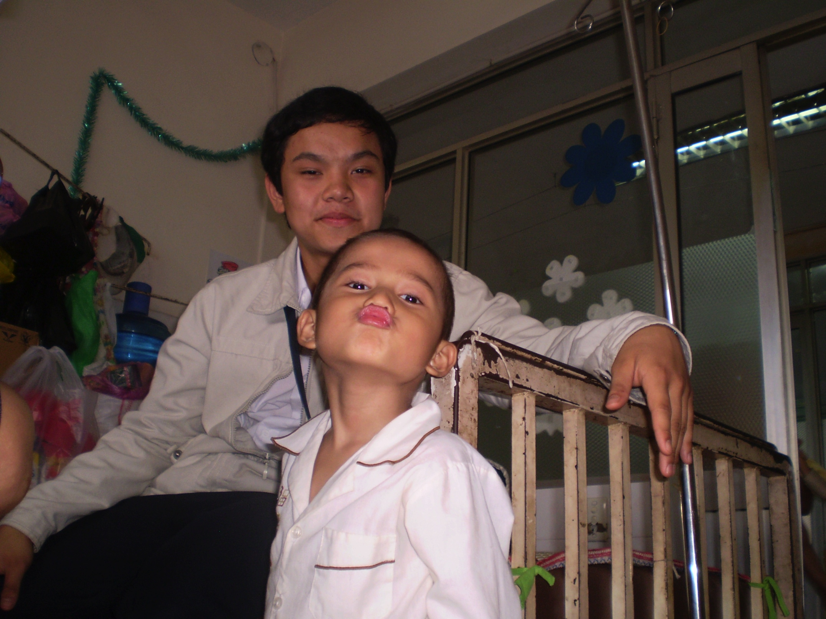

Slide 11
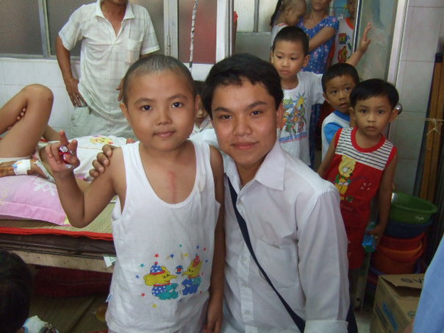
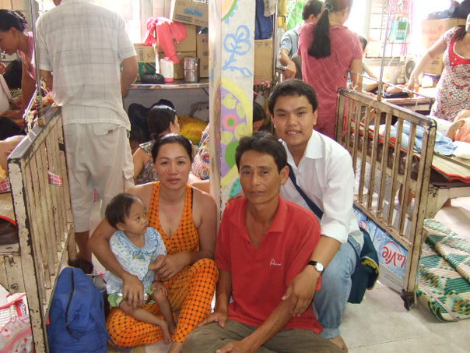
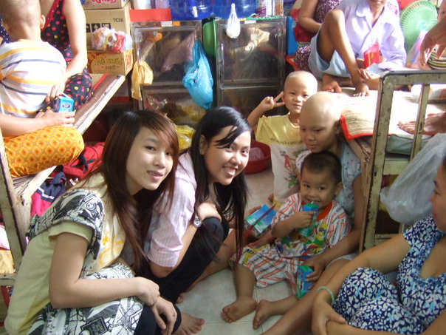
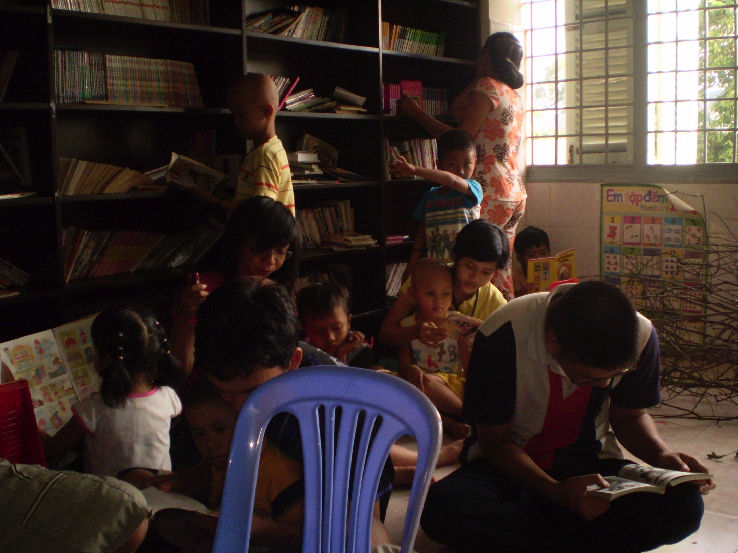

Slide 12
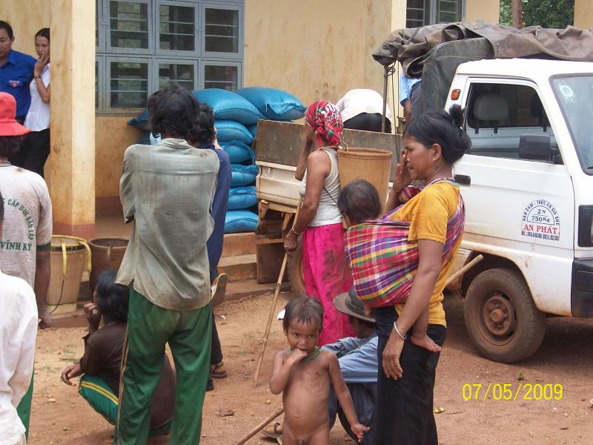
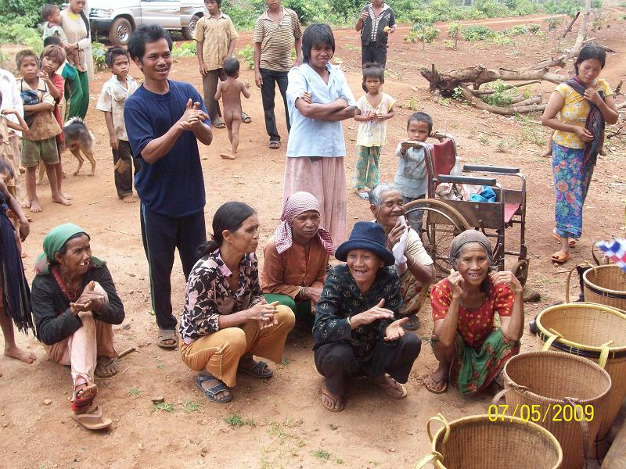
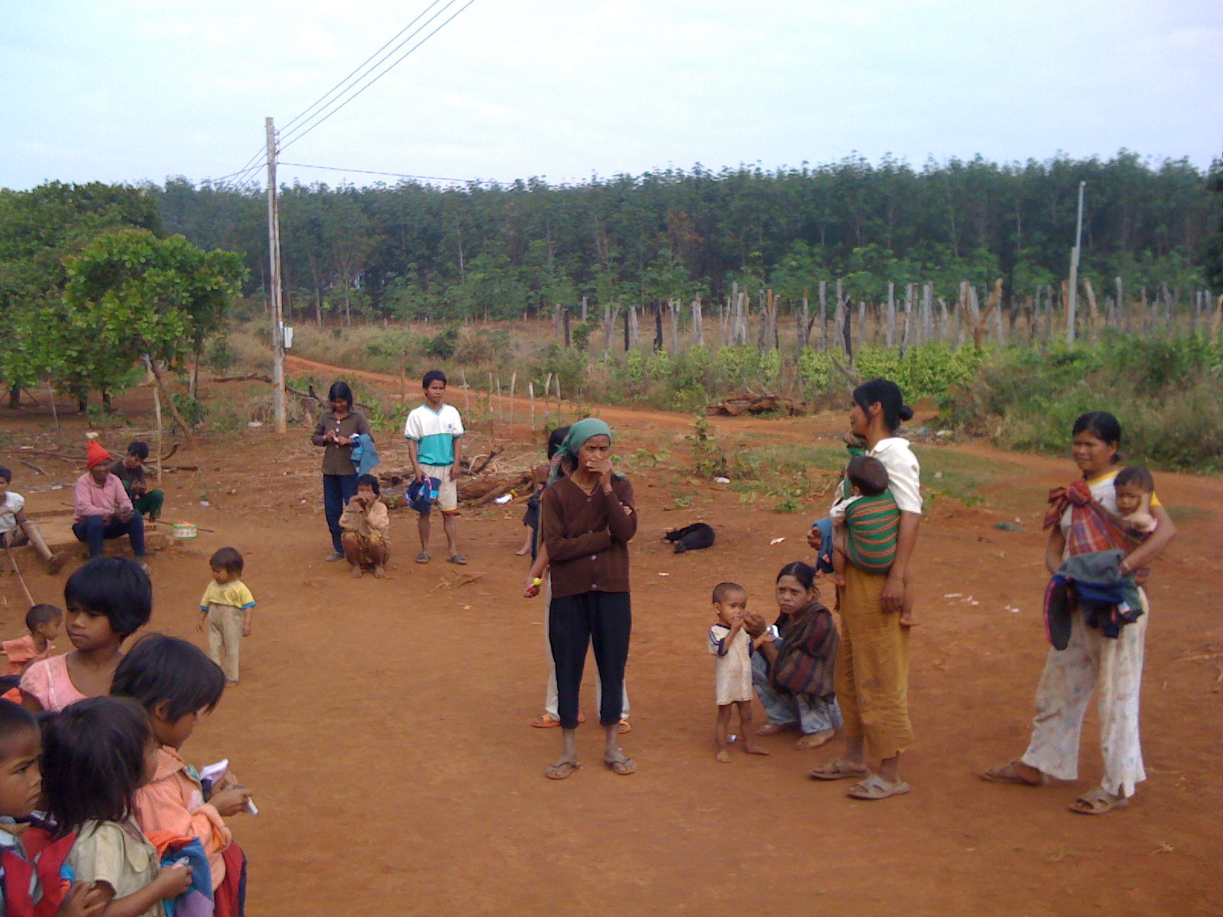
Stop Hunger
&
Poverty

Slide 13
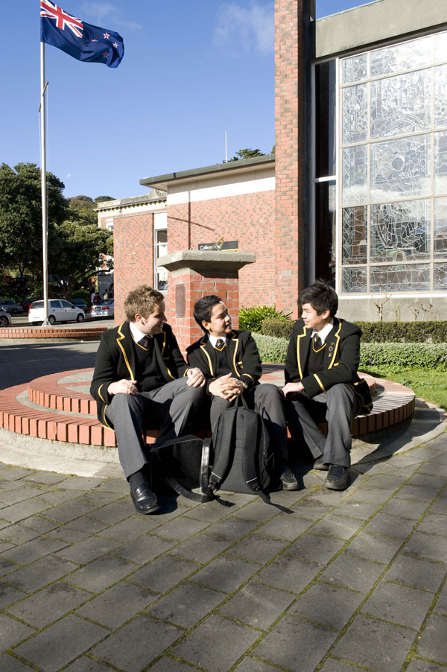
New Zealand
Project
Blue Dragon Foundation
World Vision
Compassion Center
Ending Hungers

Slide 14

Blue Dragon Foundation
Blue Dragon Children's Foundation is an Australian grassroots charity that reaches out to kids in crisis throughout Vietnam. Blue Dragon kids are street kids, children with disabilities, children from very poor families and victims of human trafficking and slavery.

Slide 15
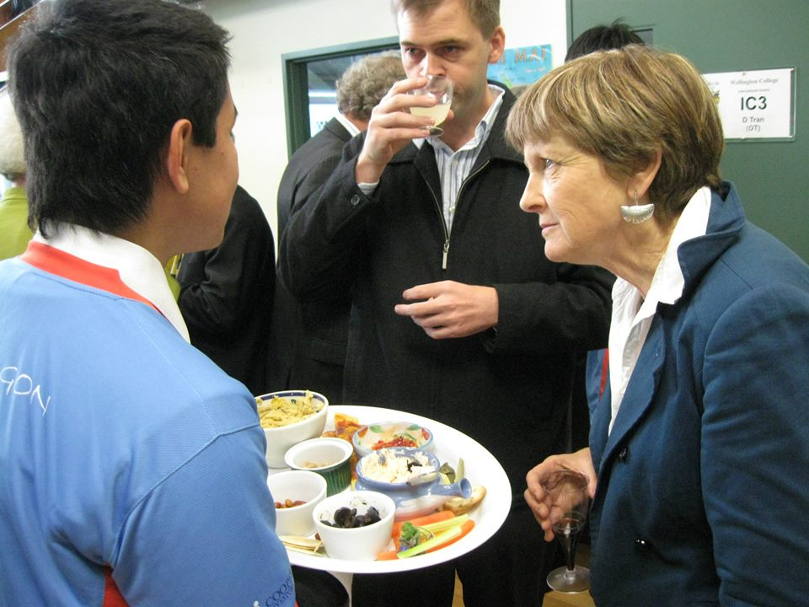
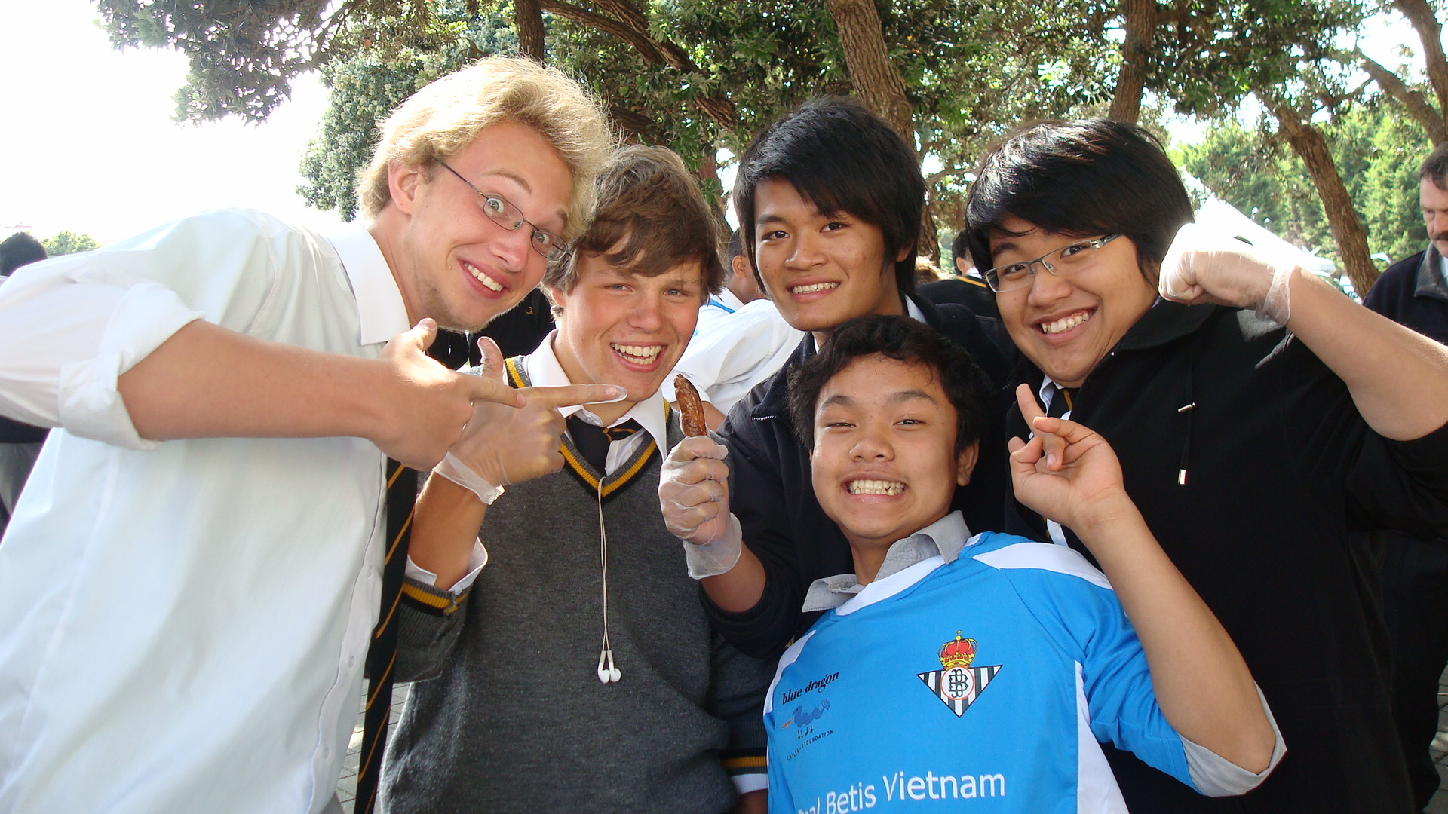
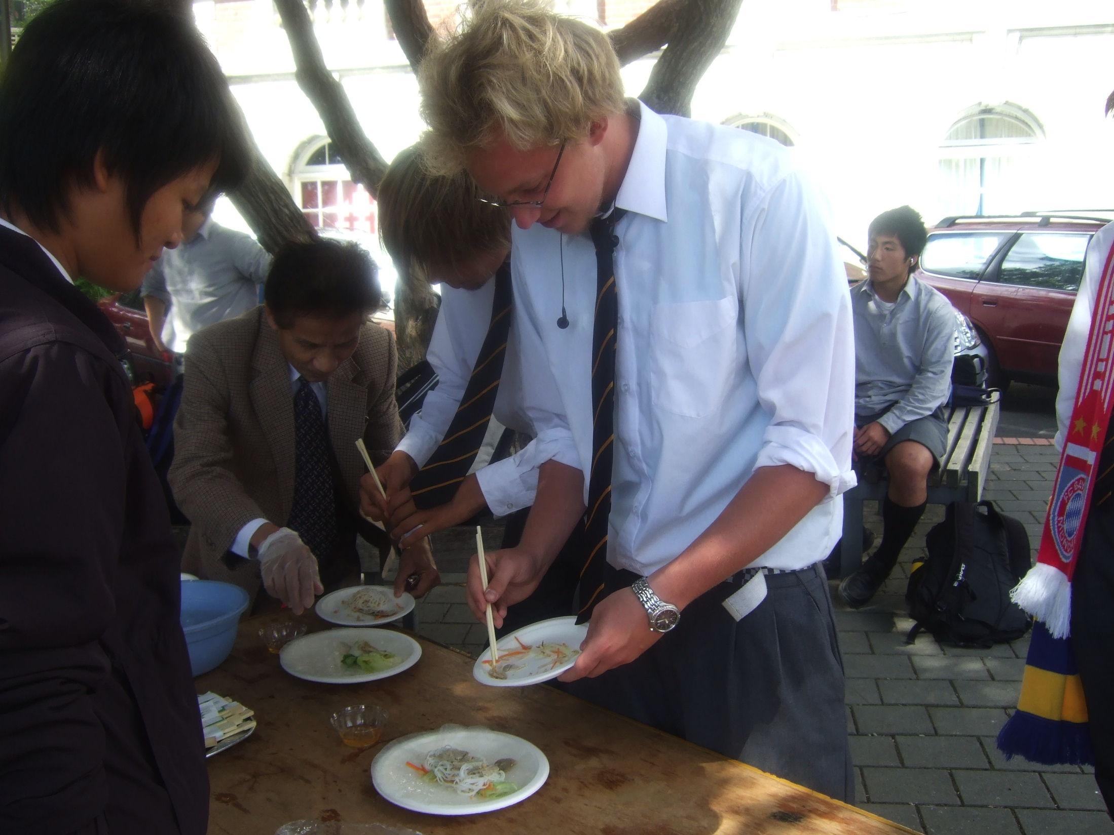
How did I support?
+ Organizing an international food fundrasiers
+ Organizing a Culture Festival
+ Organizing a City Fundraiser with the support from Wellington College and Government

Slide 16
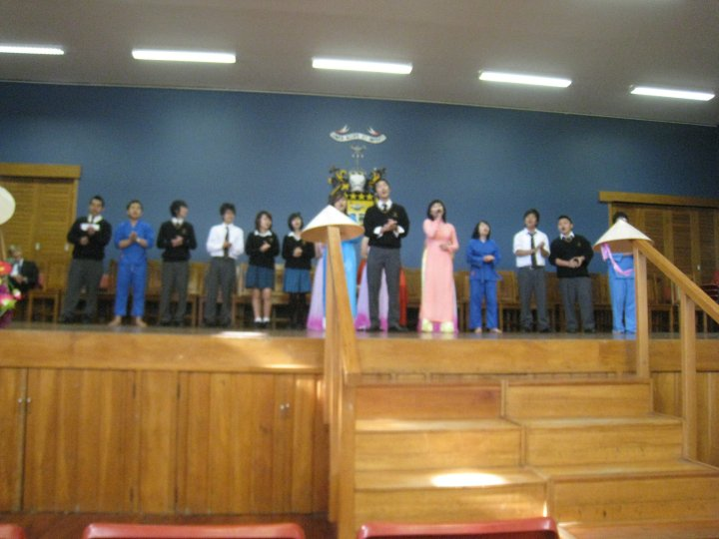
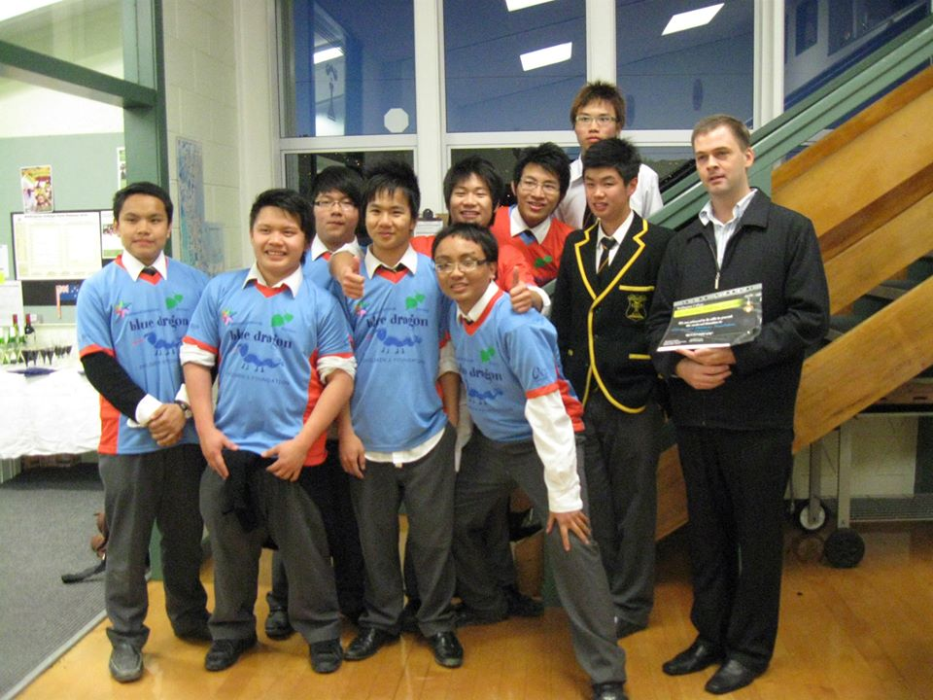


Slide 17
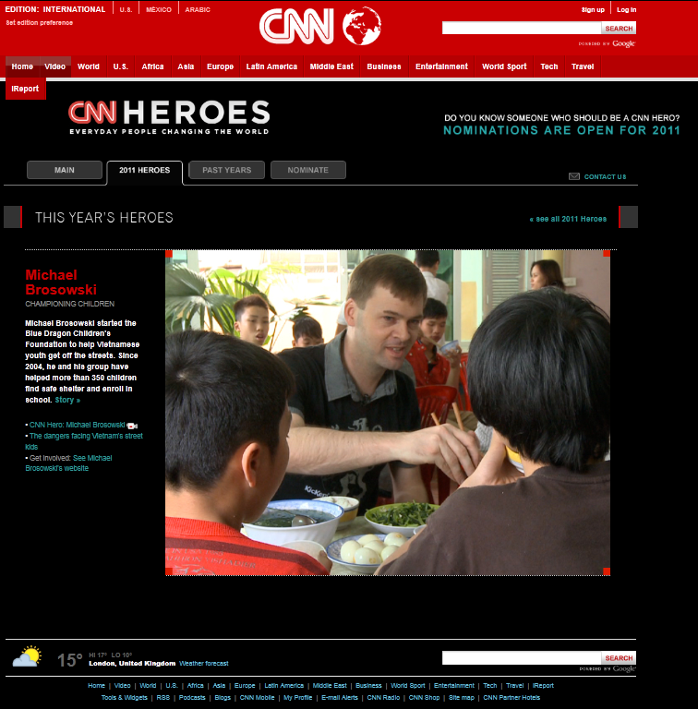
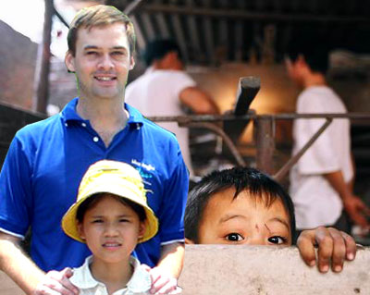
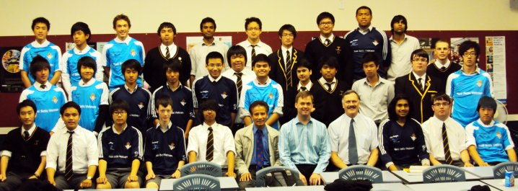

Slide 18
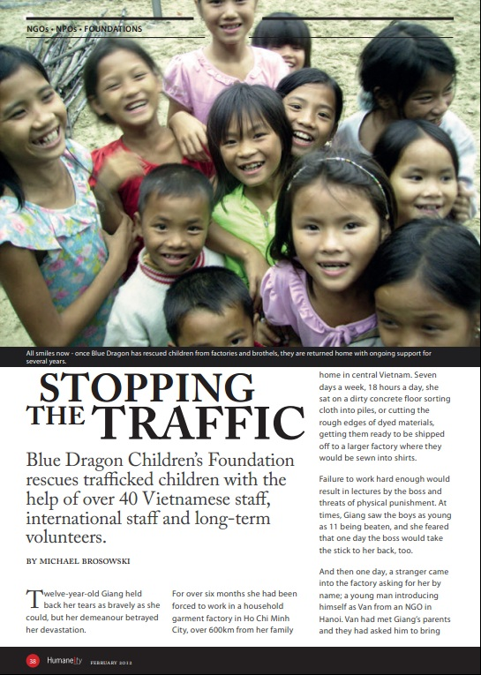
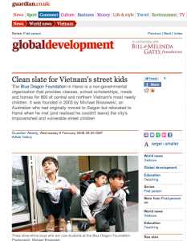

Slide 19
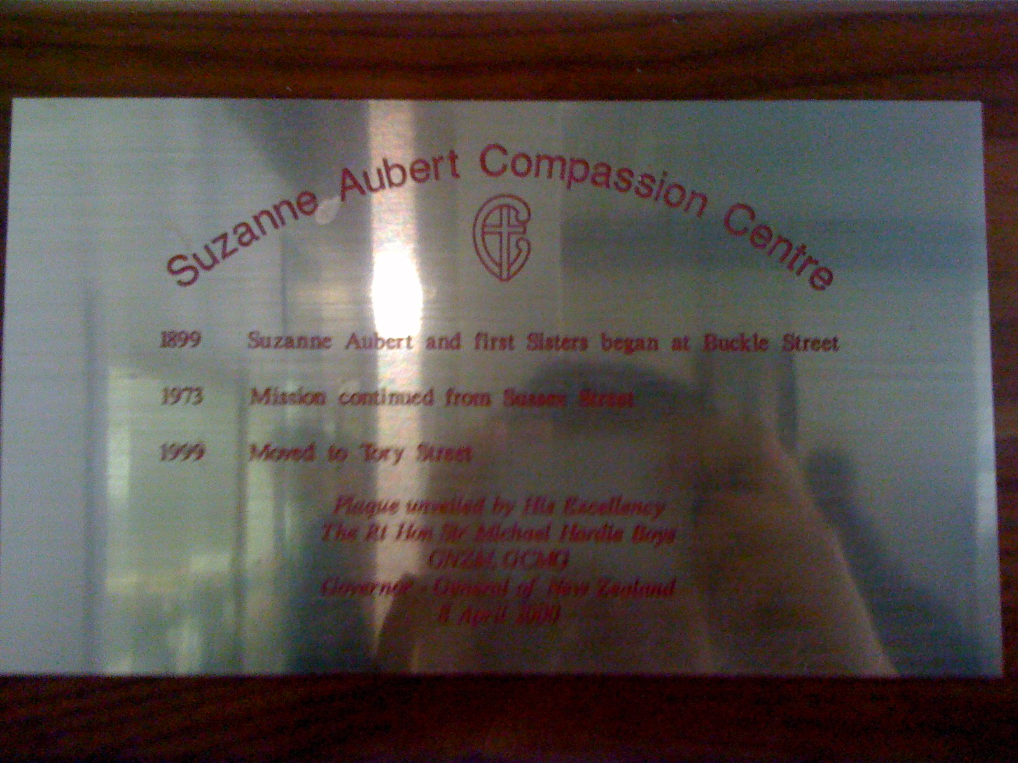
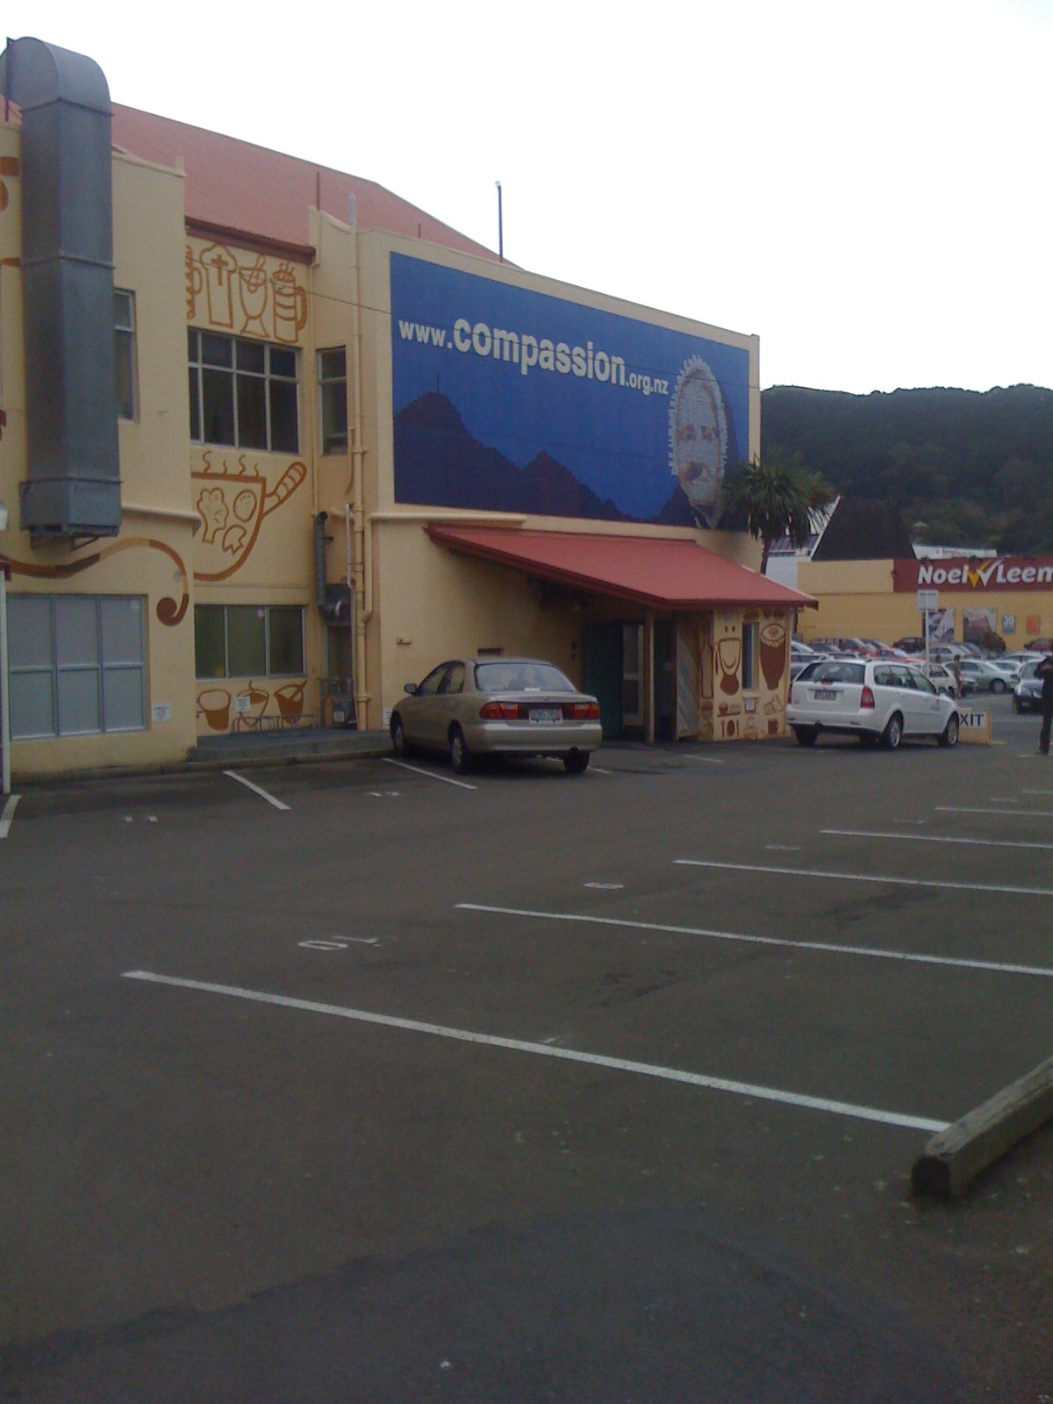
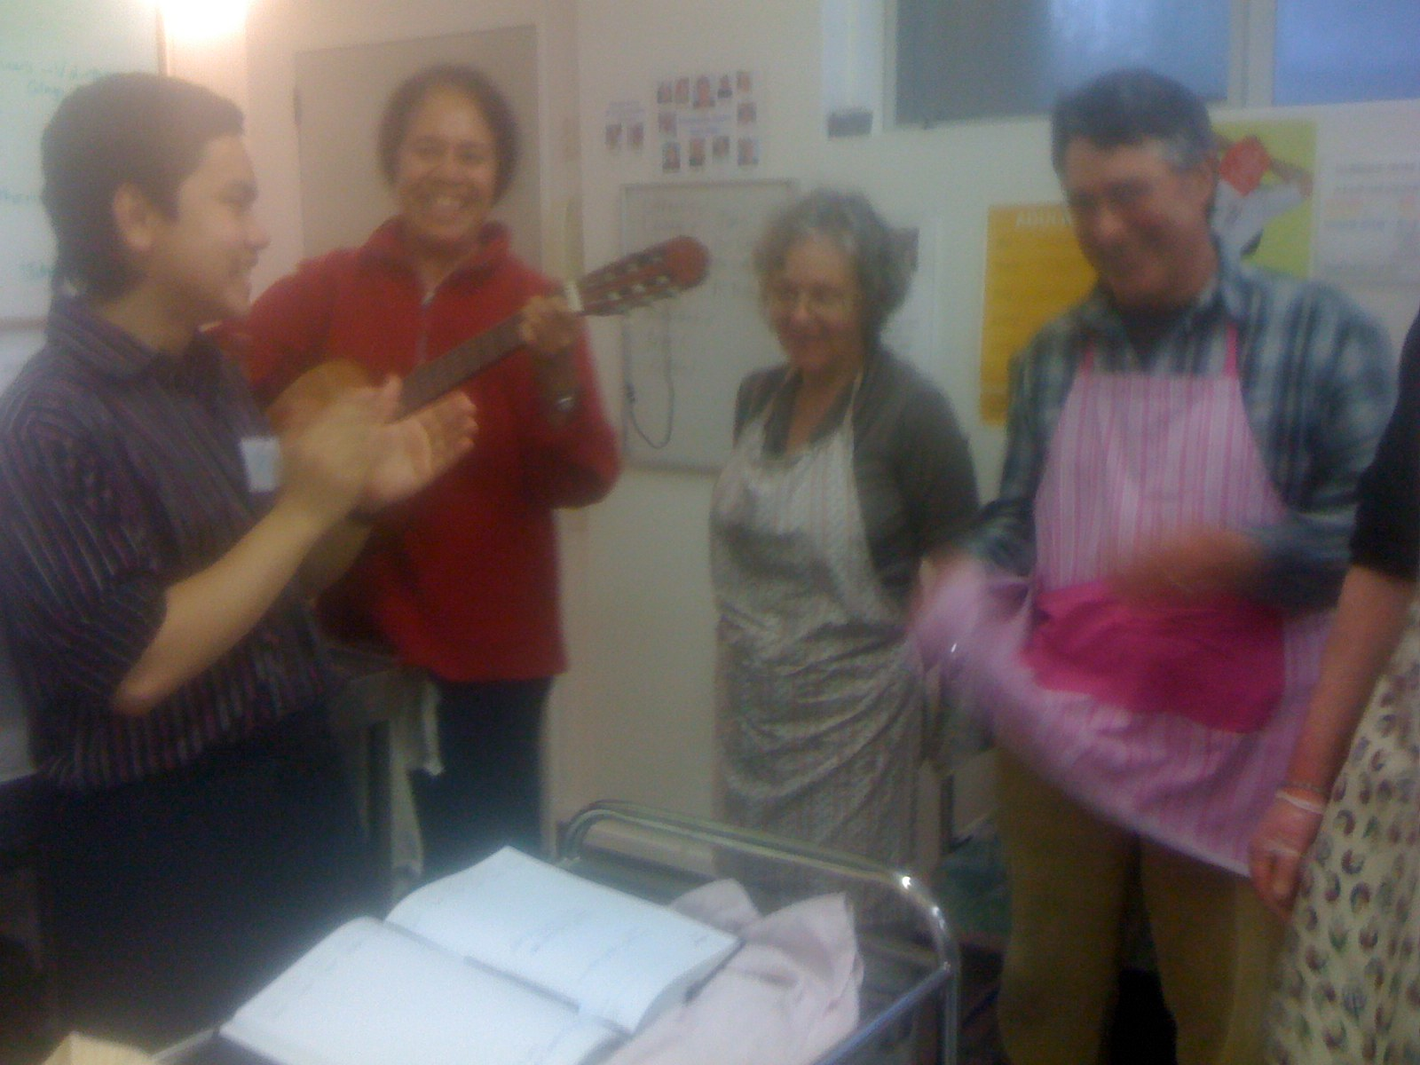

Slide 20
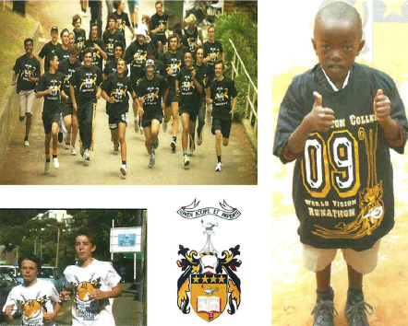
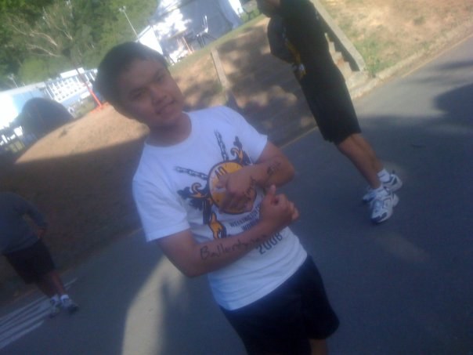
World Vision Runathon
The World Vision 40 Hour Runathon is an annual event at Wellington College (This year will be Wellington College's 16th), where students run a circuit lap around the school for donations. The general idea is students get sponsored to run a certain amount of laps. This will help raise funds for various projects World Vision supports in Tanzania.

Slide 21



America Project
Stop Hunger Now Non-Profit Org
CSUF Students Recycle
Someone Care Soup Kitchen
Community Support

Slide 22
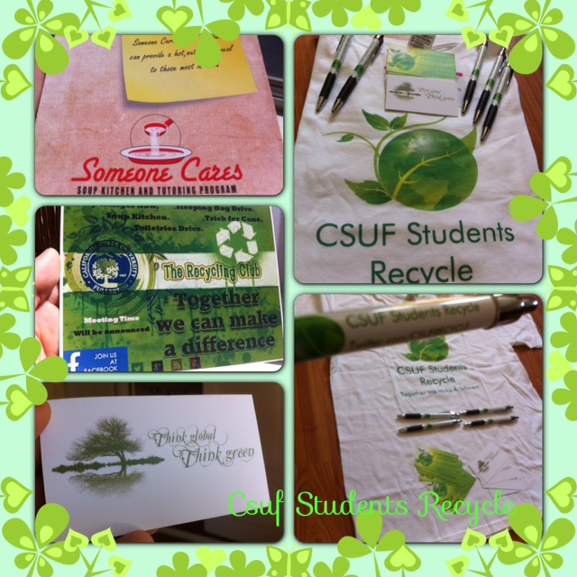

Slide 23

Someone Care Soup Kitchen
Someone Cares Soup Kitchen (Soup Kitchen) provides a daily nutritional meal to homeless, unemployed, working poor families, senior citizens, the unemployed or under-employed, the mentally and physically challenged and most important . the children.
Therefore, the Soup Kitchen provides meals seven days per week. Meals are served Monday through Friday from 12:00 p.m. to 3:00 p.m., and a breakfast is provided every Saturday and Sunday morning from 9:00 a.m. to 11:00 am.

Slide 24
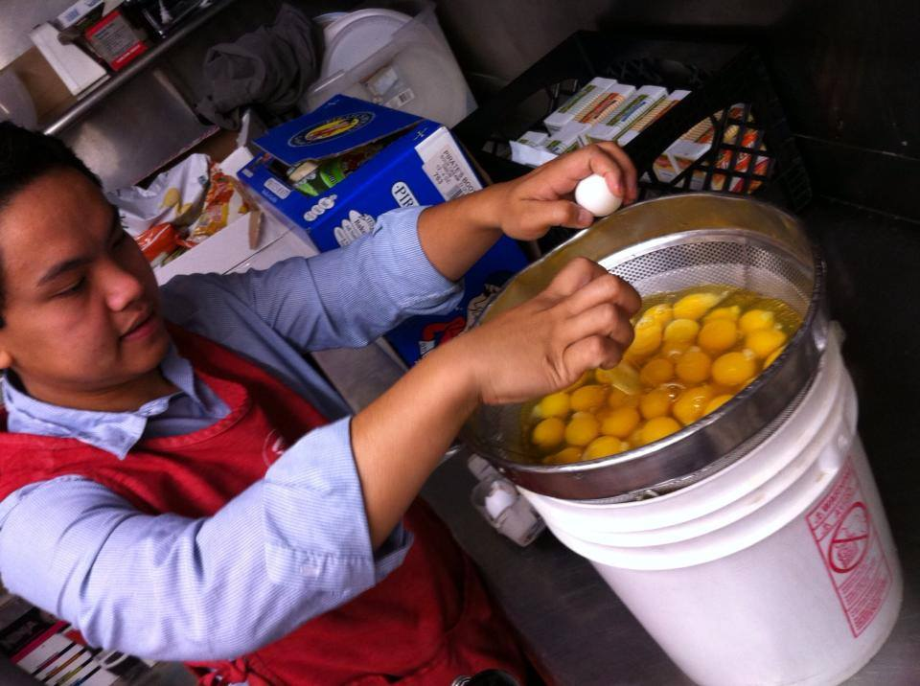
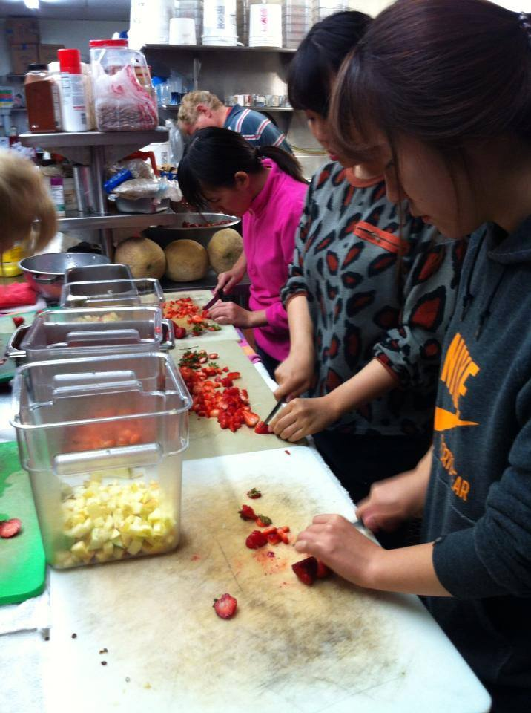


Slide 25


TOGETHER WE MAKE A DIFFERENCE

Slide 26


Slide 27

STOP HUNGER NOW
MISSION is to end hunger in our lifetime by providing food and life-saving aid to the world's most vulnerable and by creating a global commitment to mobilize the necessary resources.

Slide 28





Slide 29


Working Together To End World Hunger

Slide 30


Maintaining the park we love by volunteering to help remove non-native brush for fire suppression and re-vegetation of native plantings at Peters Canyon Regional Park

Slide 31


Slide 32



Slide 33



Slide 34


SKY PHAM
PBD Public Relation Officer
CSUF Students Recycle President
Contact Information
Phone: 714-759-0980
Email: Spham0168@csu.fullerton.edu
Sky@fvchamber.com

